Slide 1




FINAL PRESENTATION
04-24-2023
Account Supervisor
Angela Schmidt
Account Executives
Juliana Berkowitz, Angelina Engira, Jingwen Tan, & Lily Yates

Slide 2
AGENDA
01
02
03
04
05
05
06
07
08
Meet the team
Client summary
focus
Objective shift
Services
Results
Reflection
Q&A

Slide 3
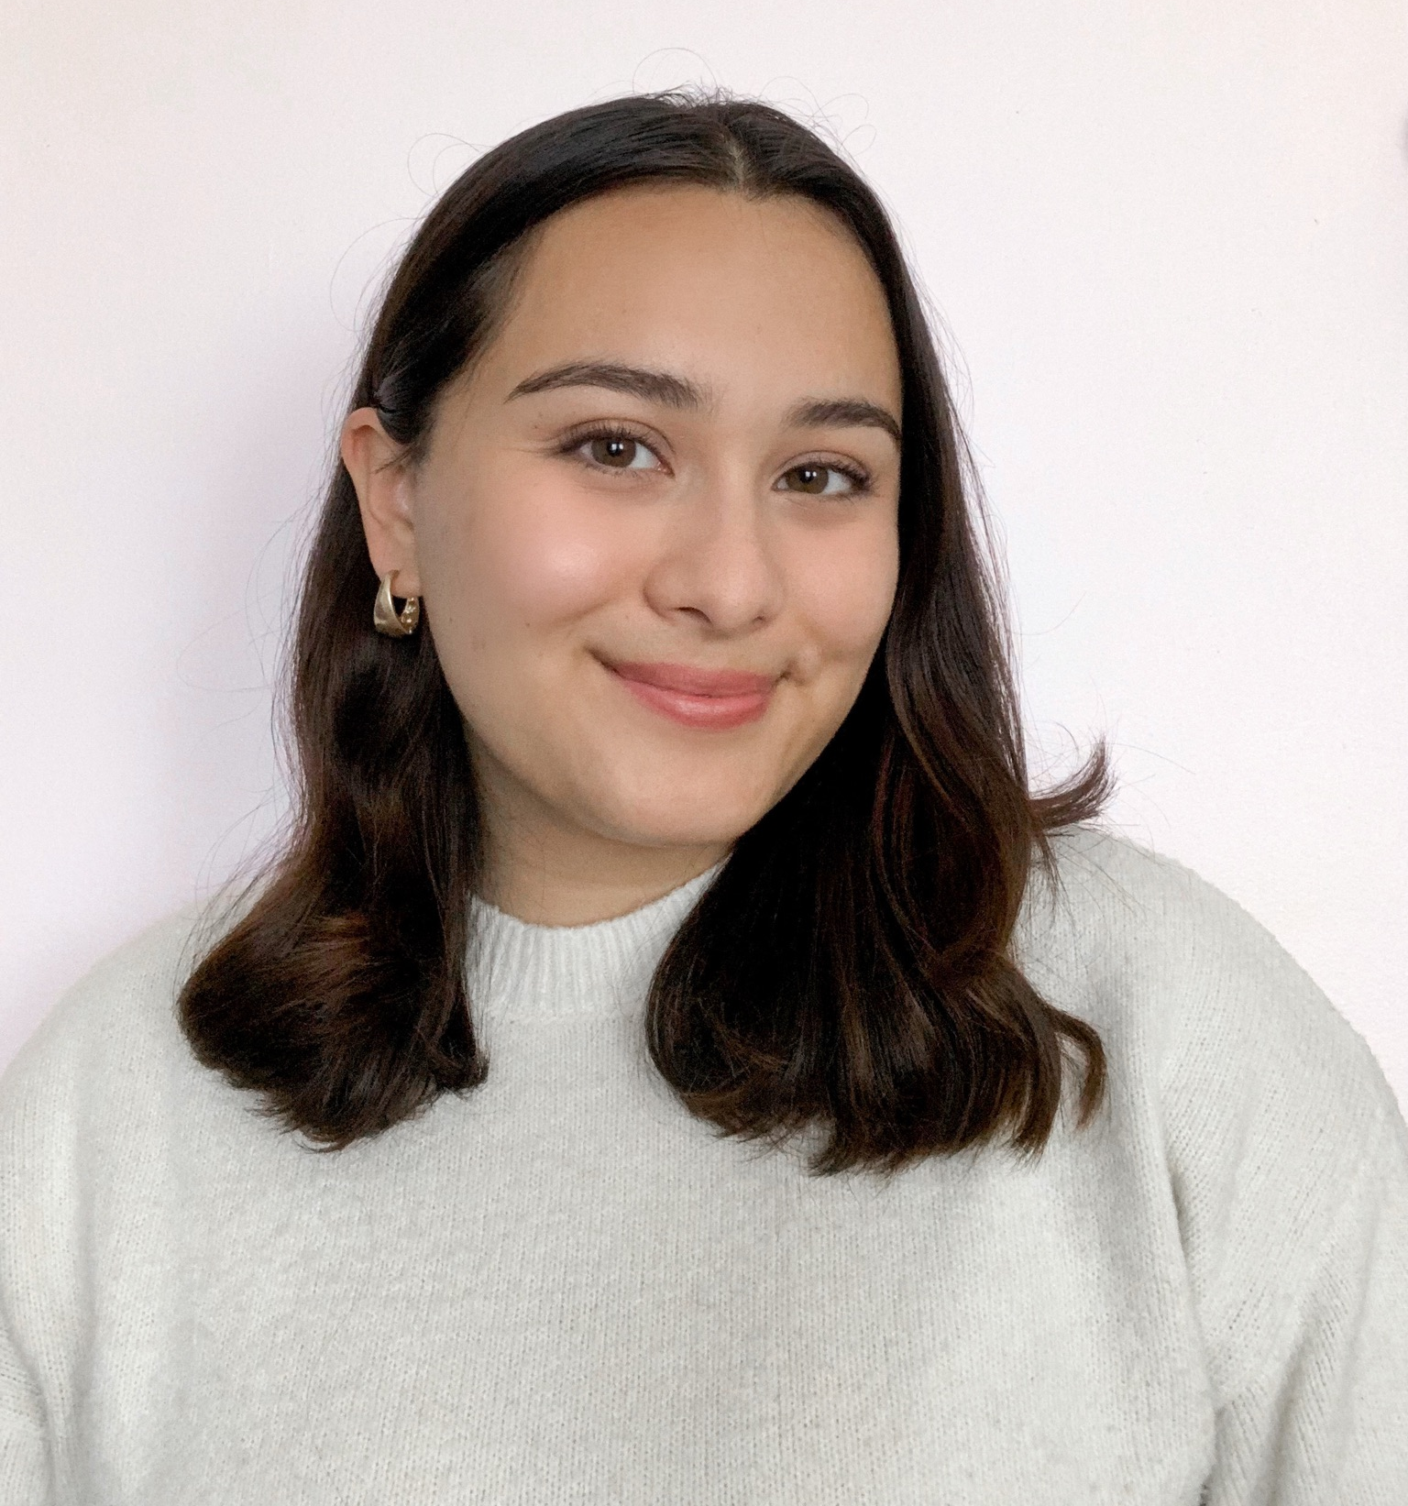
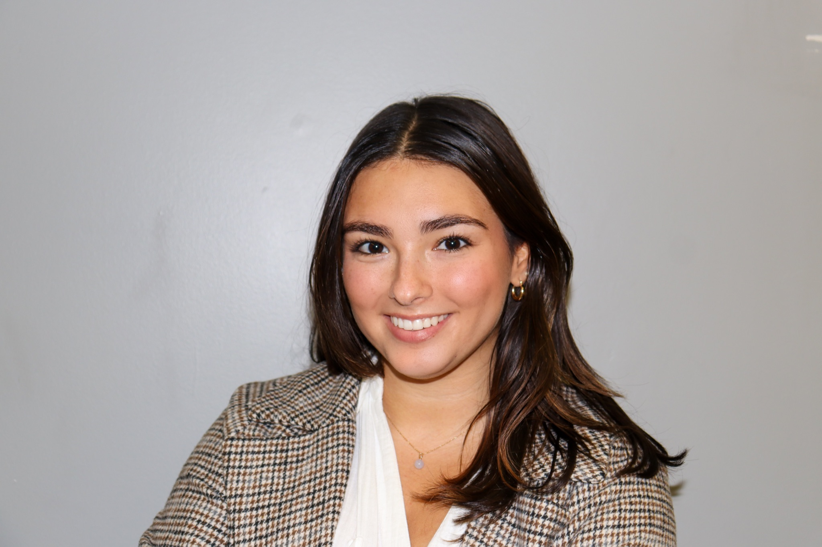
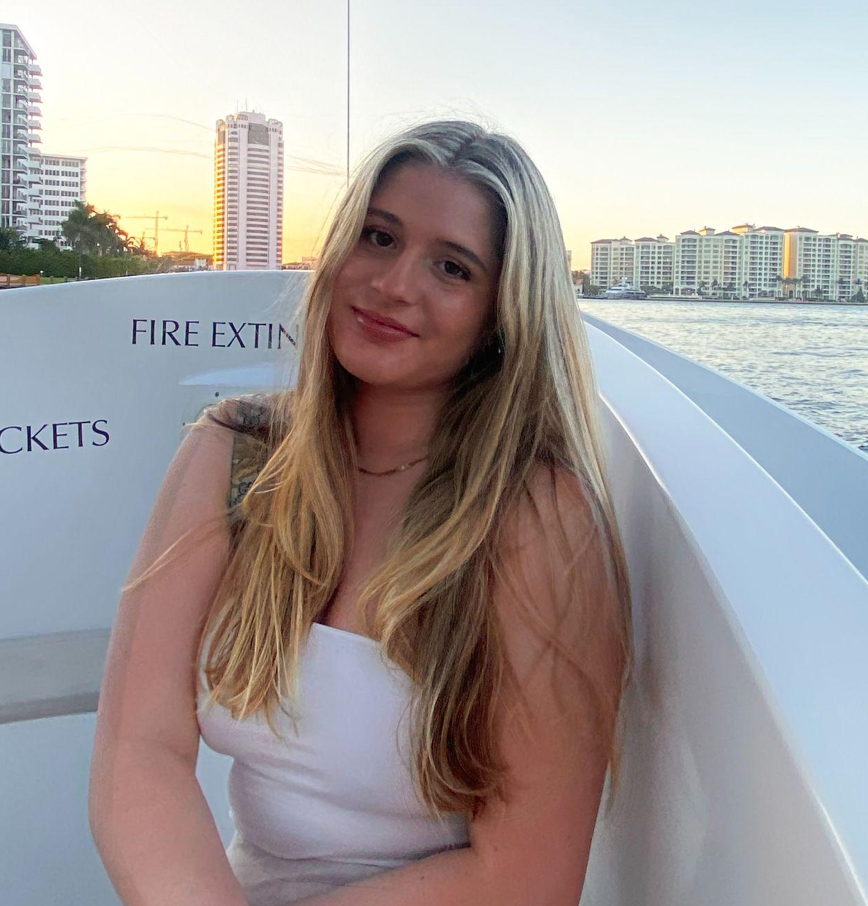
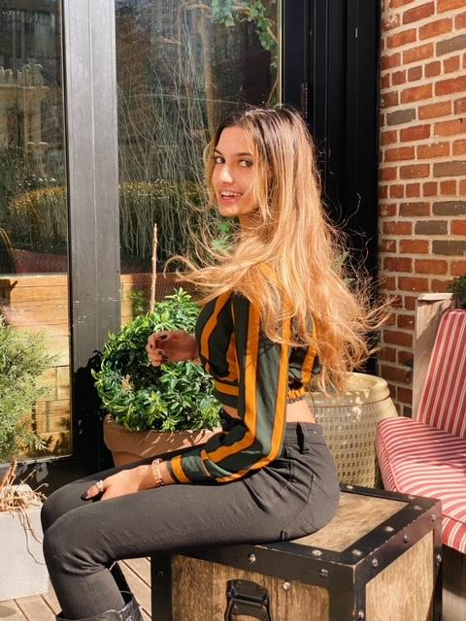
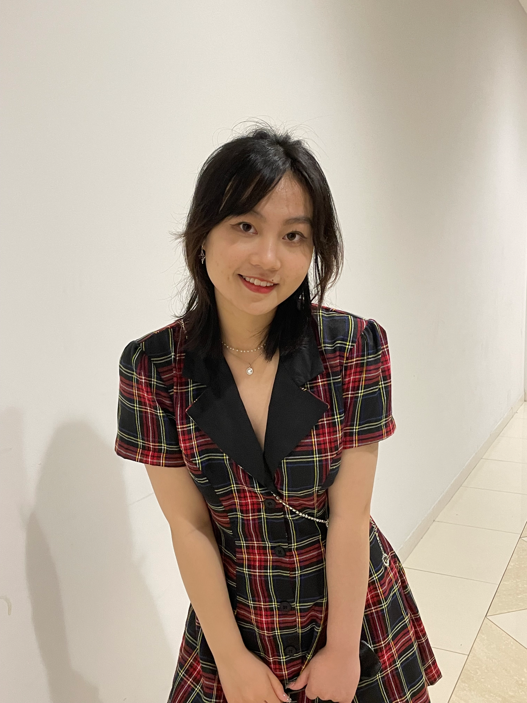
Meet the team
01
Angela
supr.
JULIANA
exec.
Lily
exec.
ANgelina
exec.
Wendy
exec.

Slide 4
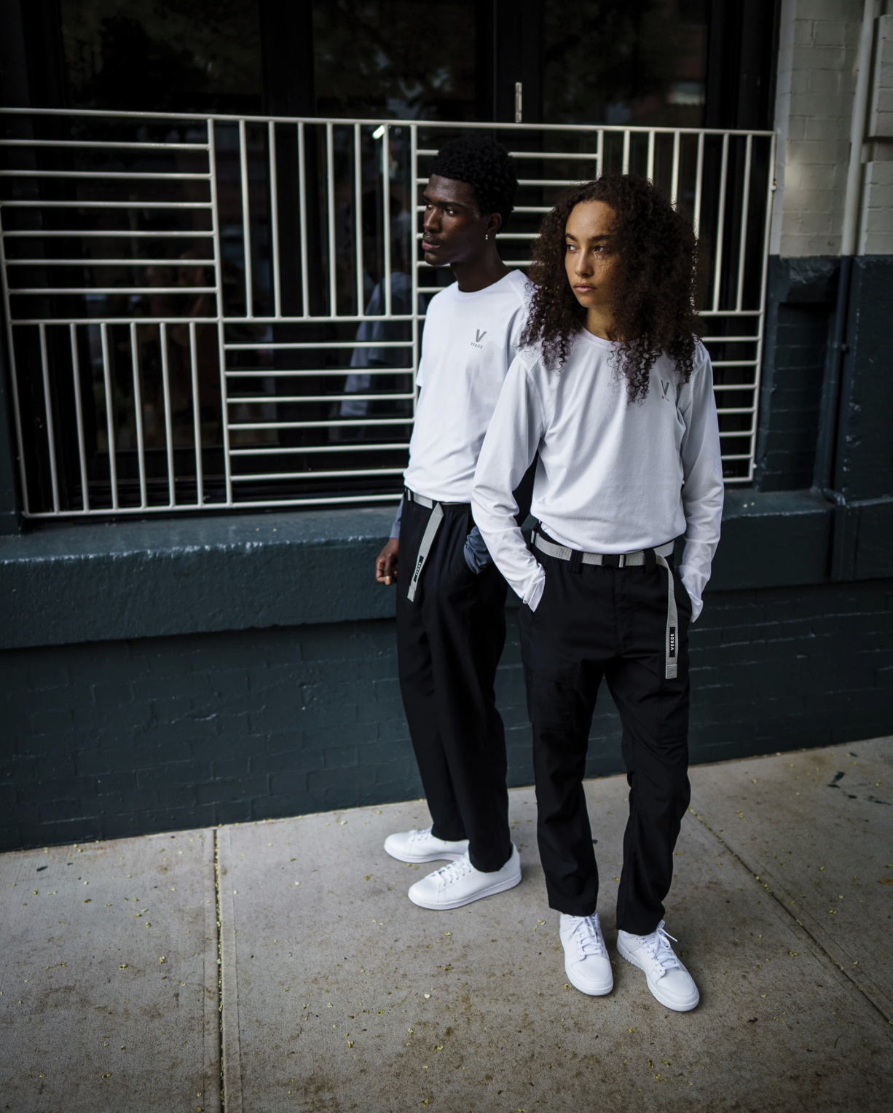
02 Client summary
“A New Uniform for Daily Life”
Founded by three fashion industry professionals, VERDE is a healthcare apparel and accessories lifestyle brand that blends traditional American sportswear with technical design elements.
Notes:
LILY

Slide 5
03 focus
“Enhance VERDE’s social media presence and brand awareness through creative content strategies and influencer partnerships.”
Notes:
Discuss photographer details, finding shoot locations Lily
LILY

Slide 6
Media relations → Influencer Relations
Social Media Engagement → Create New Content
04 Objective shift
Notes:
angelina

Slide 7
SERVICES
05

Slide 8
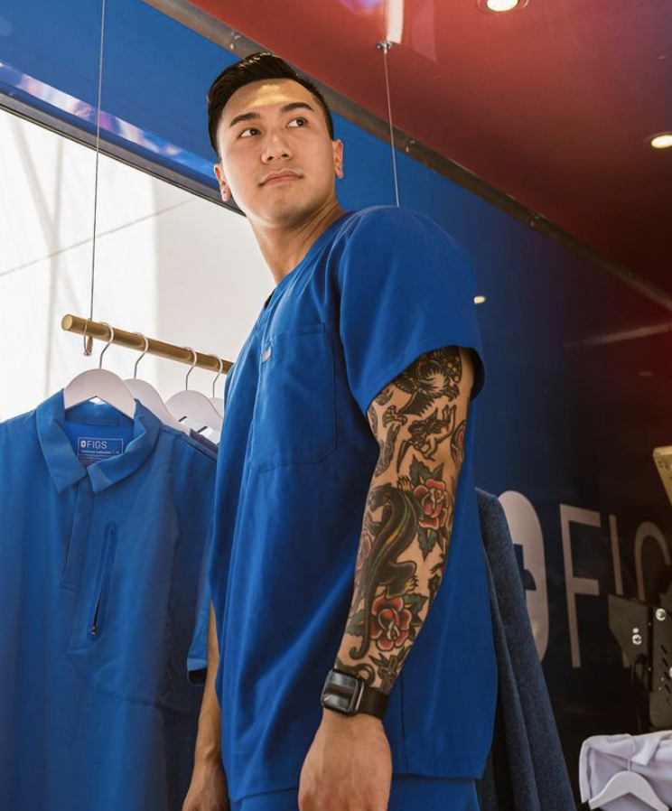
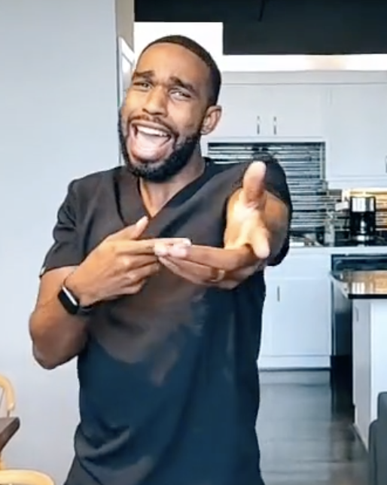
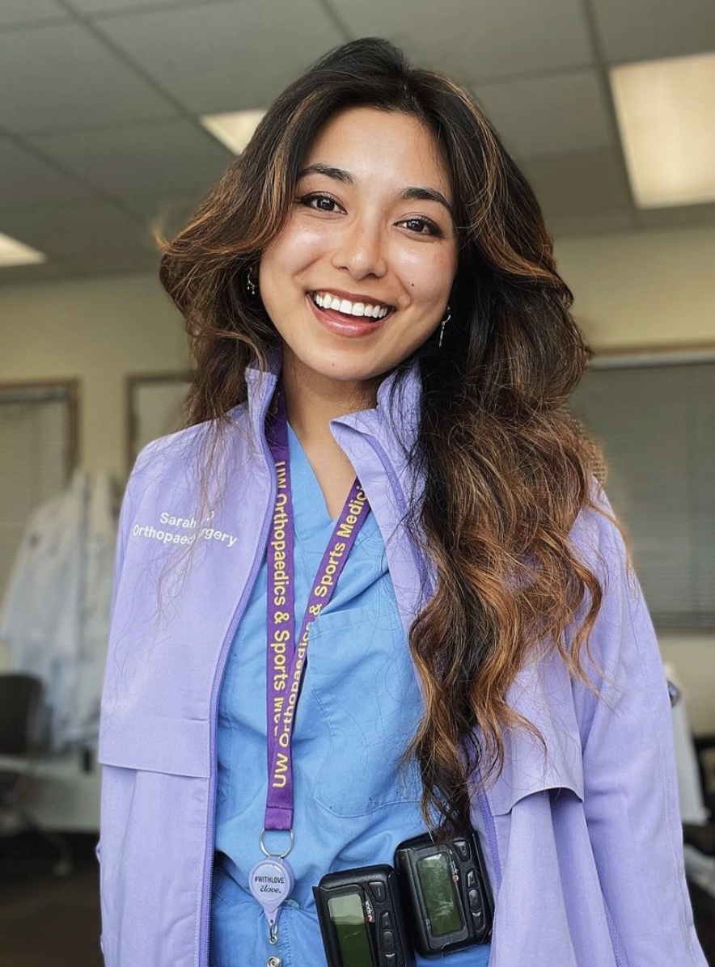
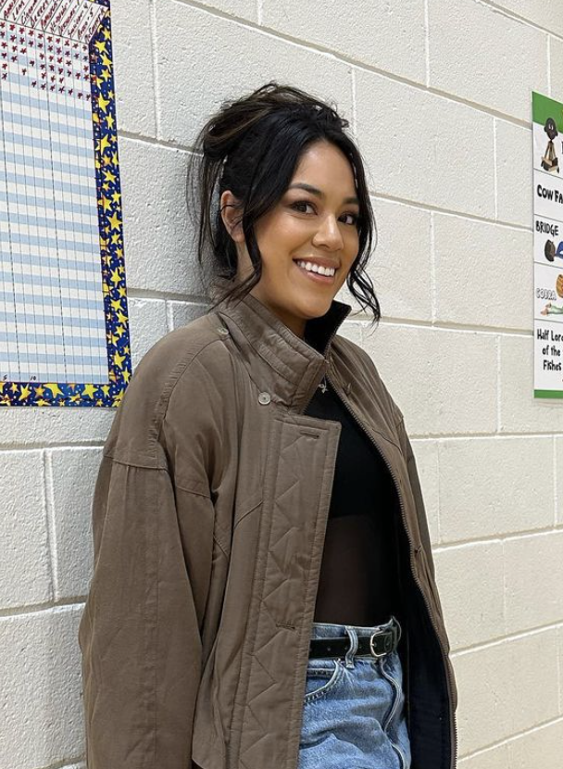
Influencer relations
@rn_aaron
@doctorphabs
@outoftheor
@drmelissa
Notes:
JULES

Slide 9
Influencer relations
Created list of med-fluencers
Sent email pitches
Sent order info to client
Focused on paid partnerships
Men
Created list of med-fluencers
Sent emails: gifting of bags
Sent order info to client
women
Notes:
JULES

Slide 10
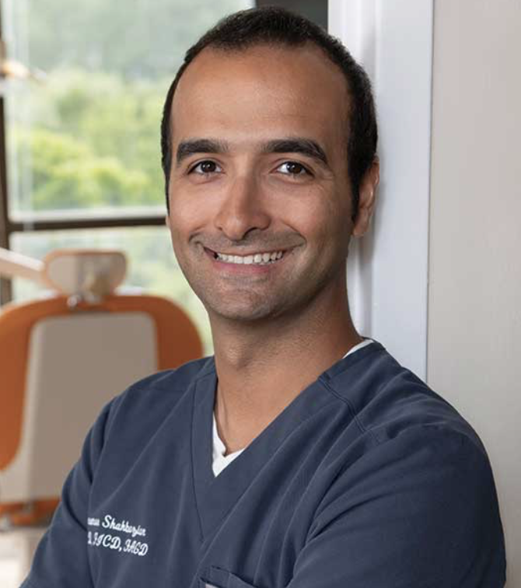
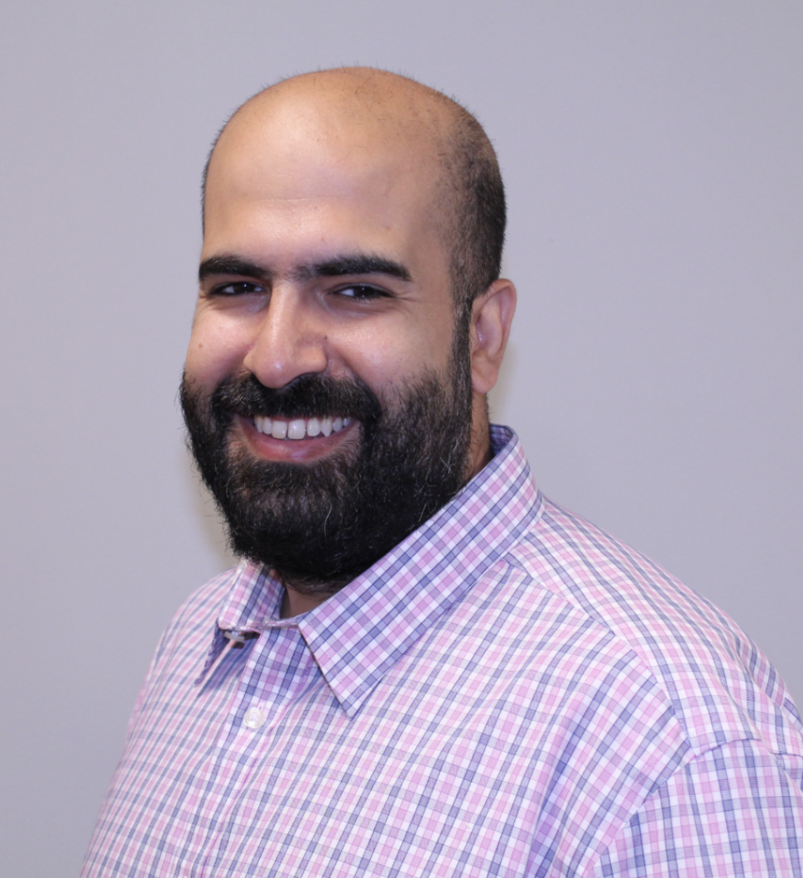
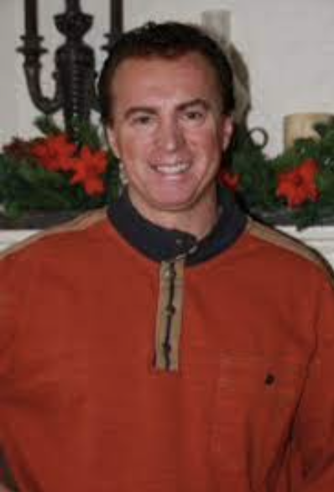
Doctor Outreach
Dr. Shahbazian
Dr. Altaweel
Denie Bernier
Notes:
WENDY

Slide 11
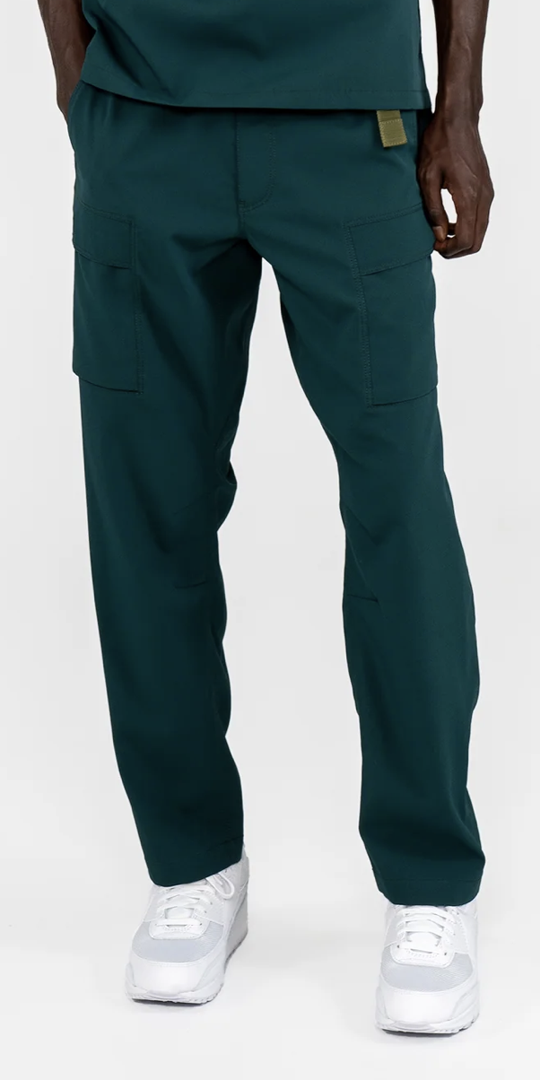
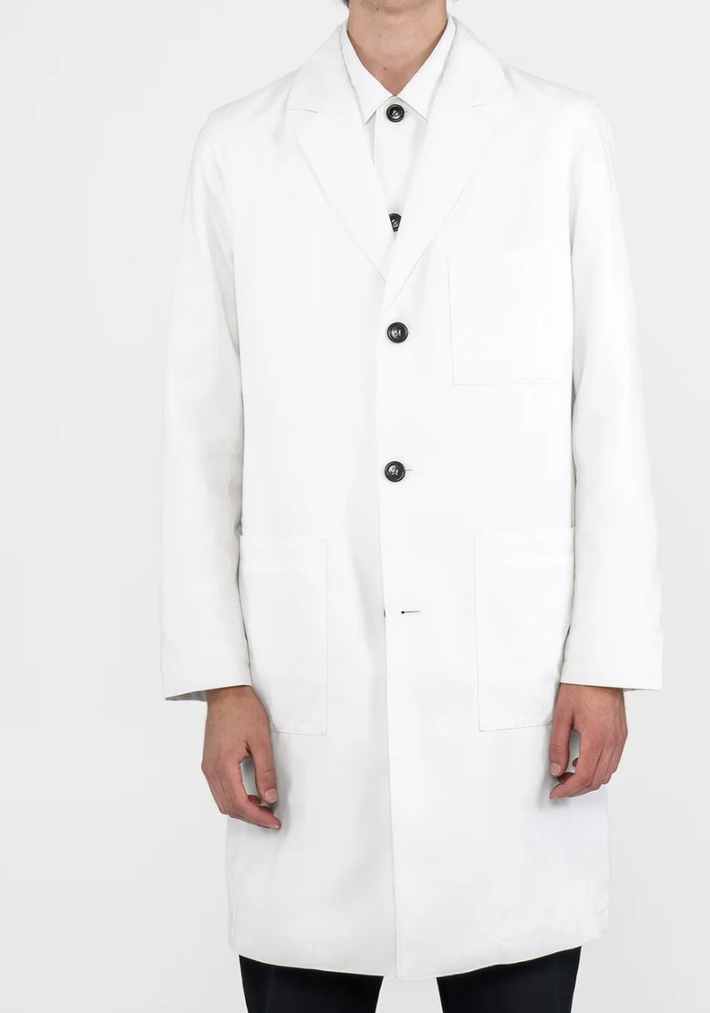
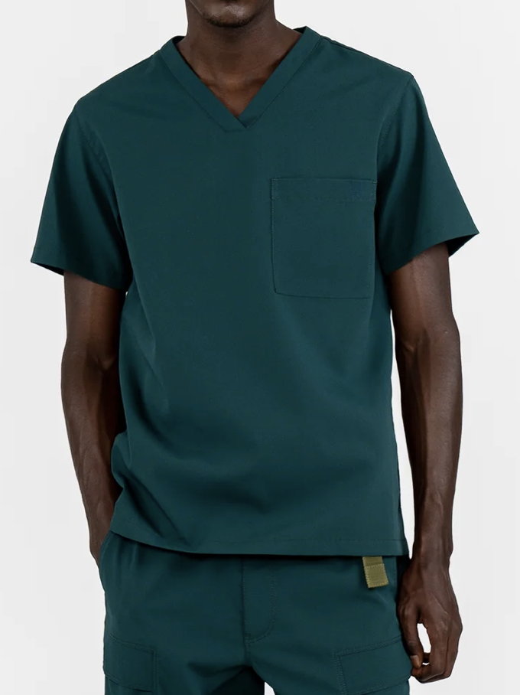
Doctor Outreach
Email Outreach
Personalized emails: sending VERDE products + discussing partnerships
Continued communication
Answering questions about VERDE / products
Orders
Facilitated order process for product send-out
Notes:
WENDY

Slide 12

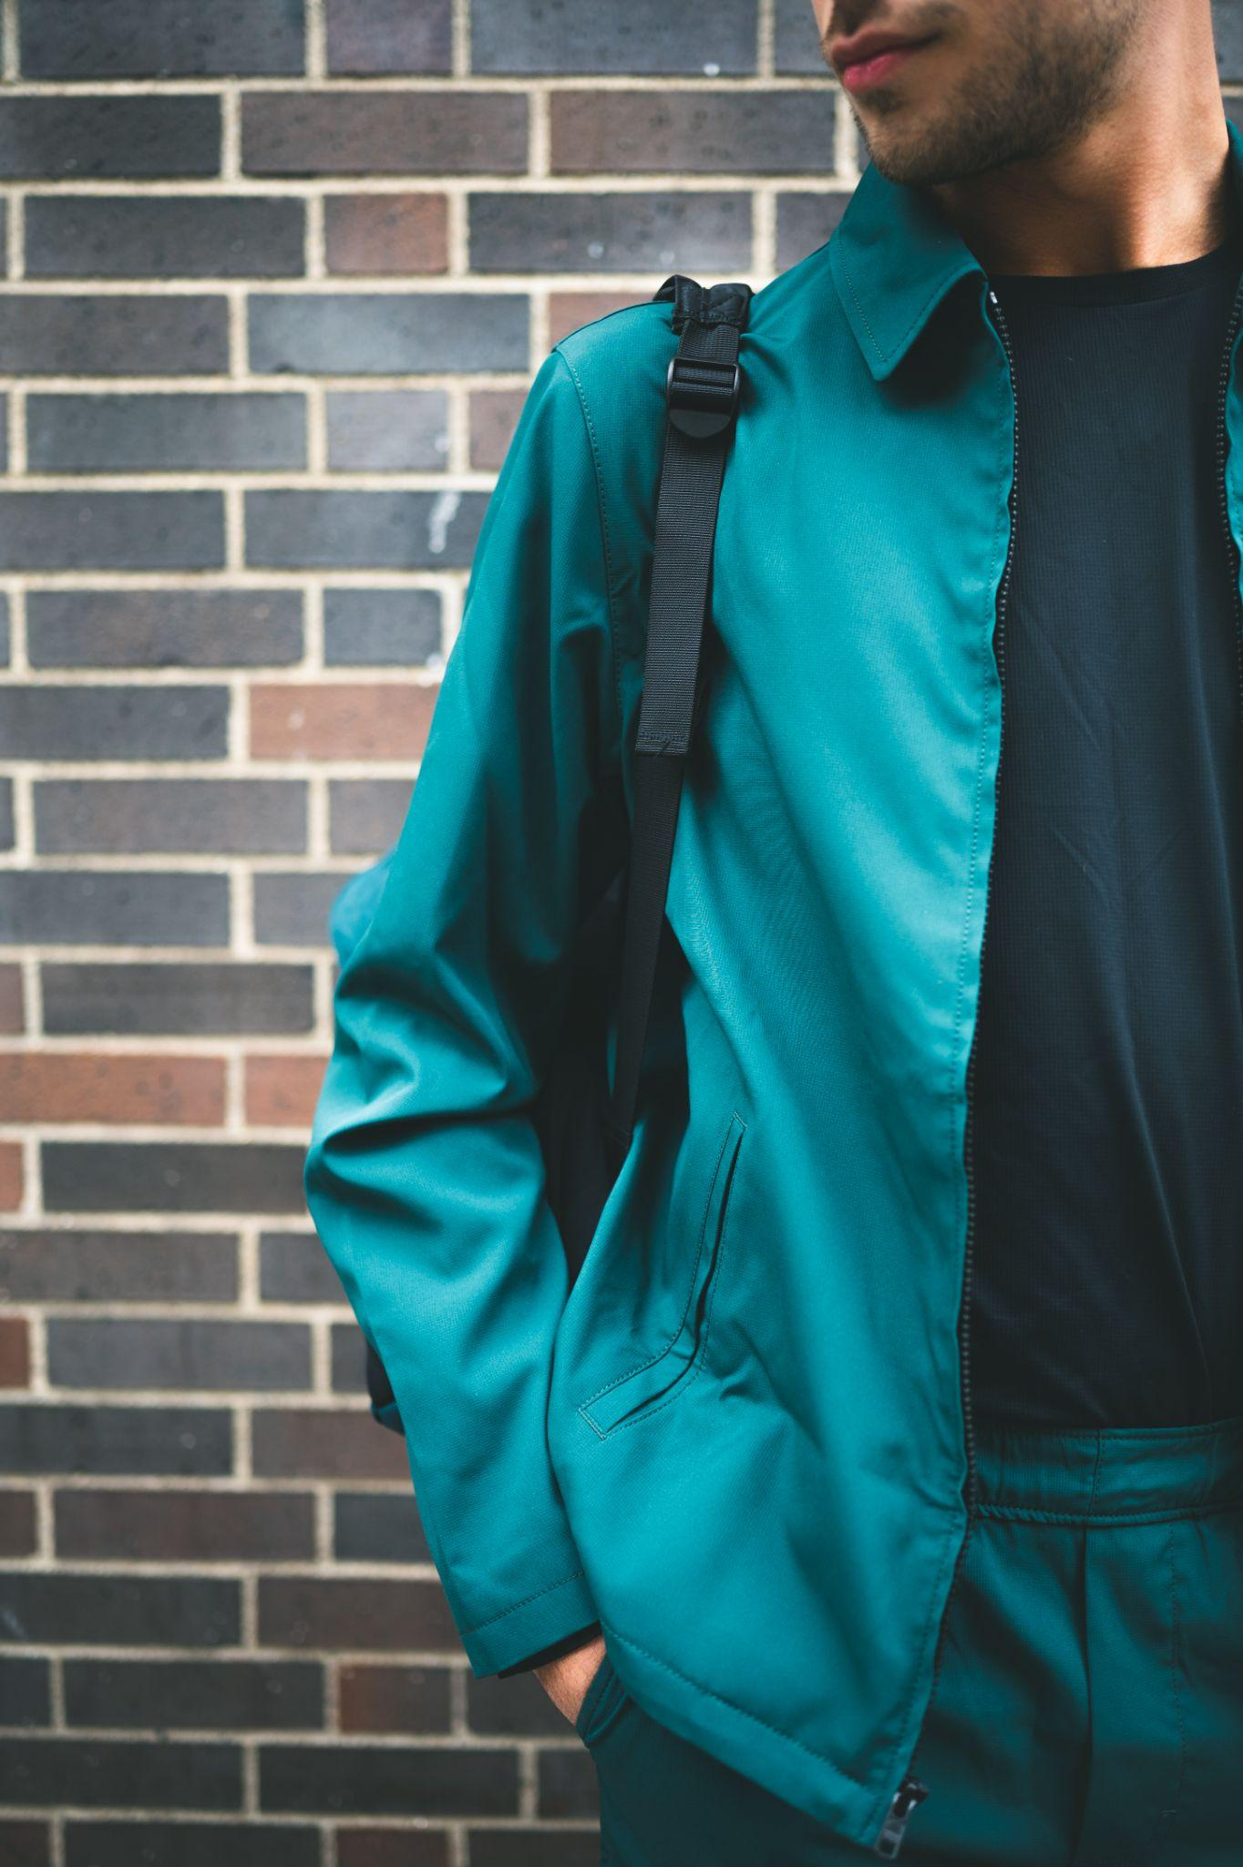
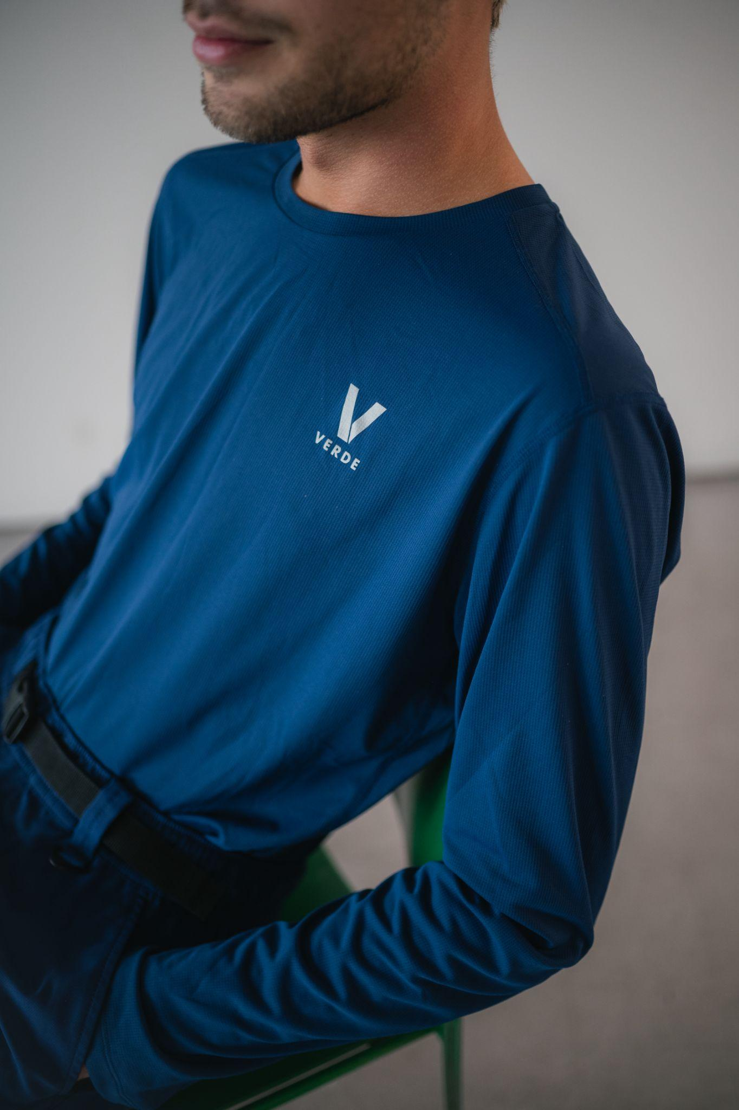
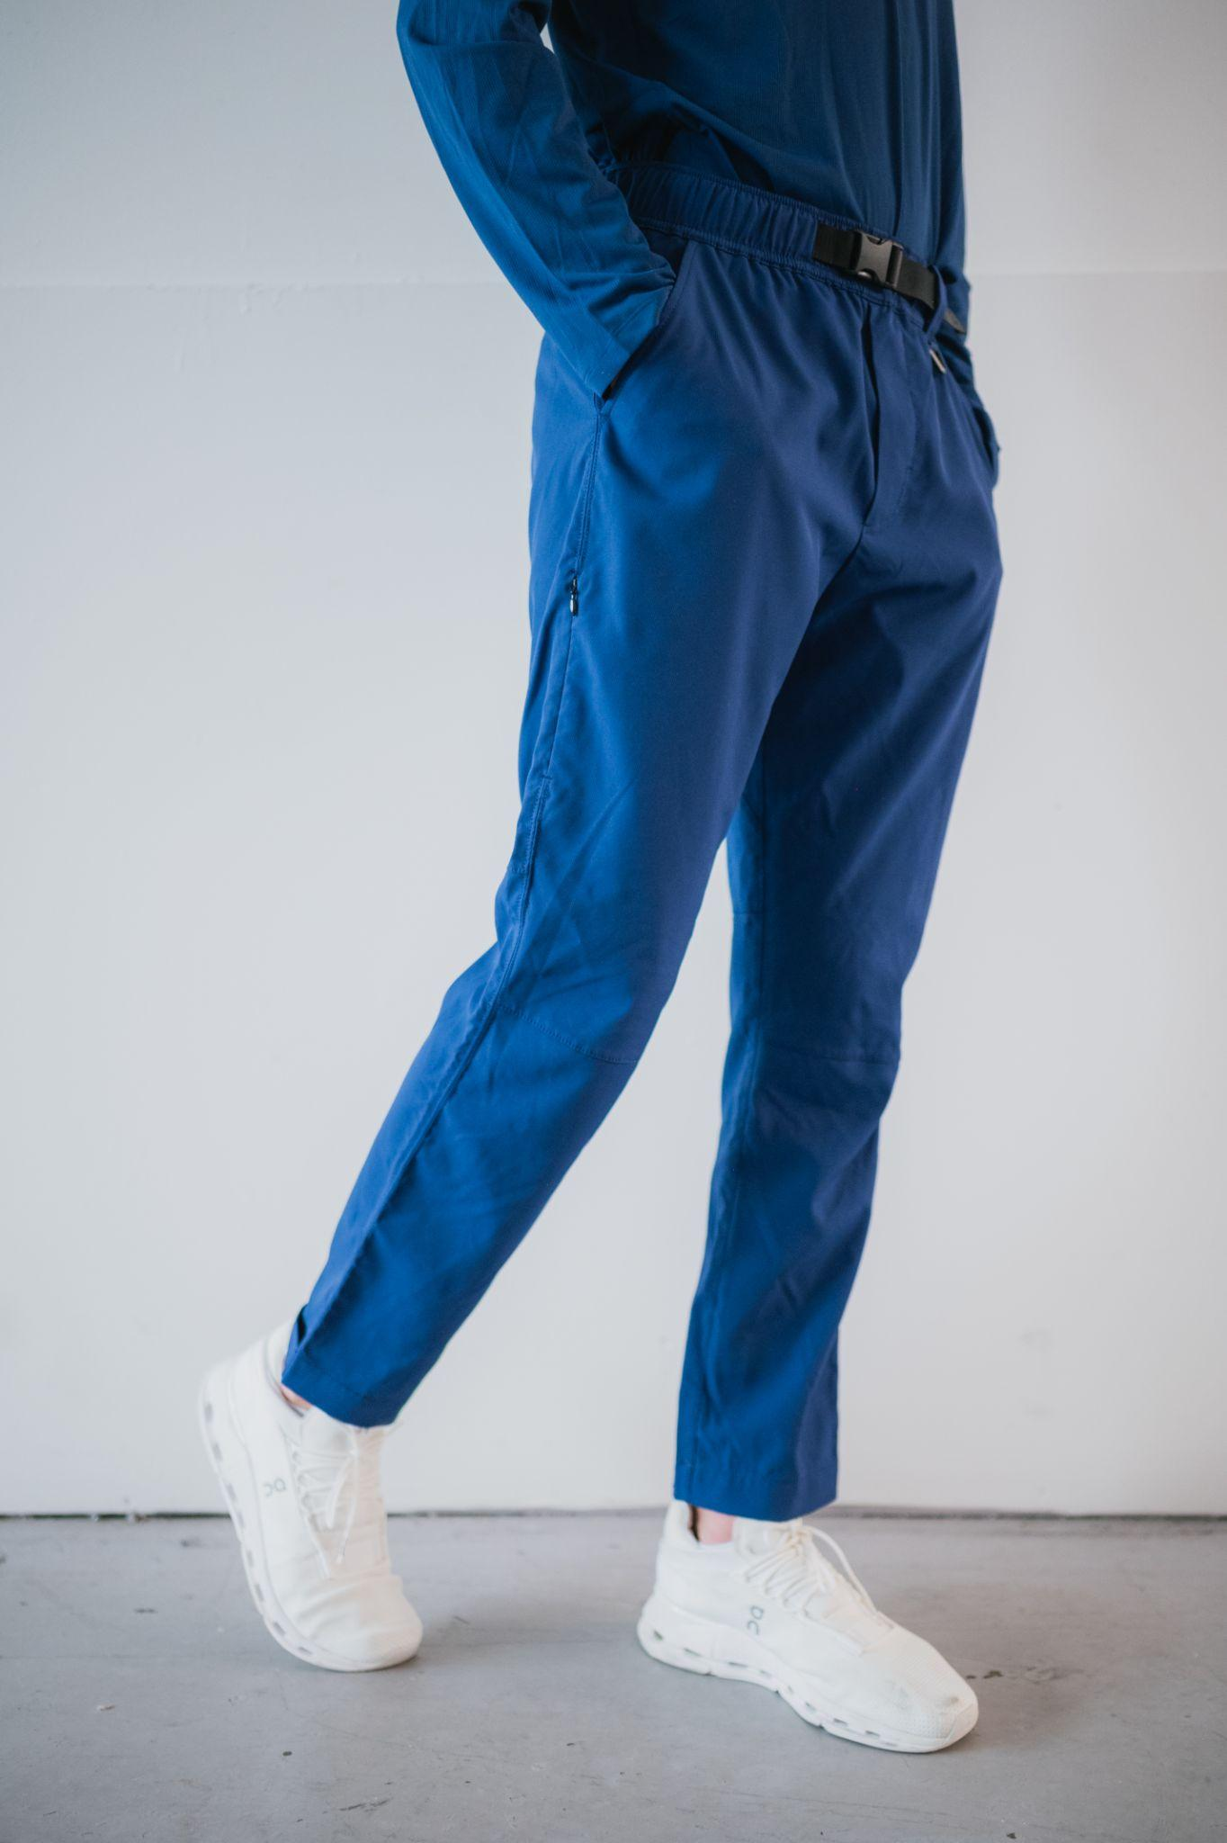
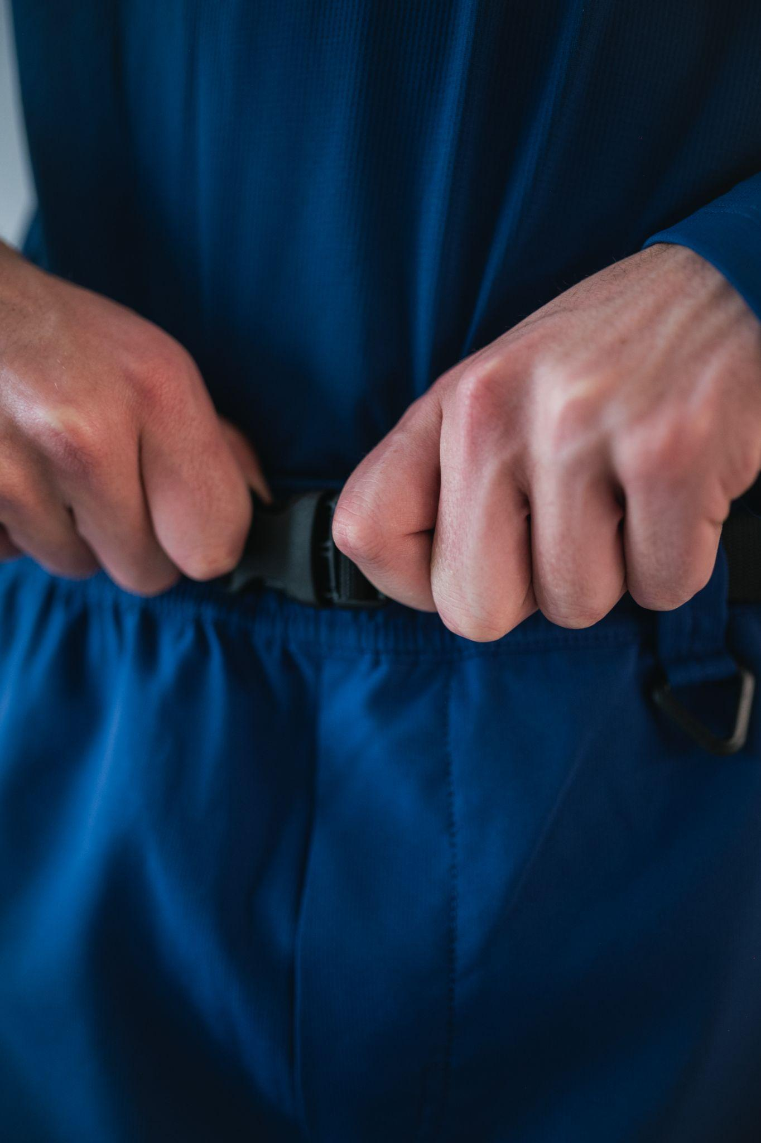
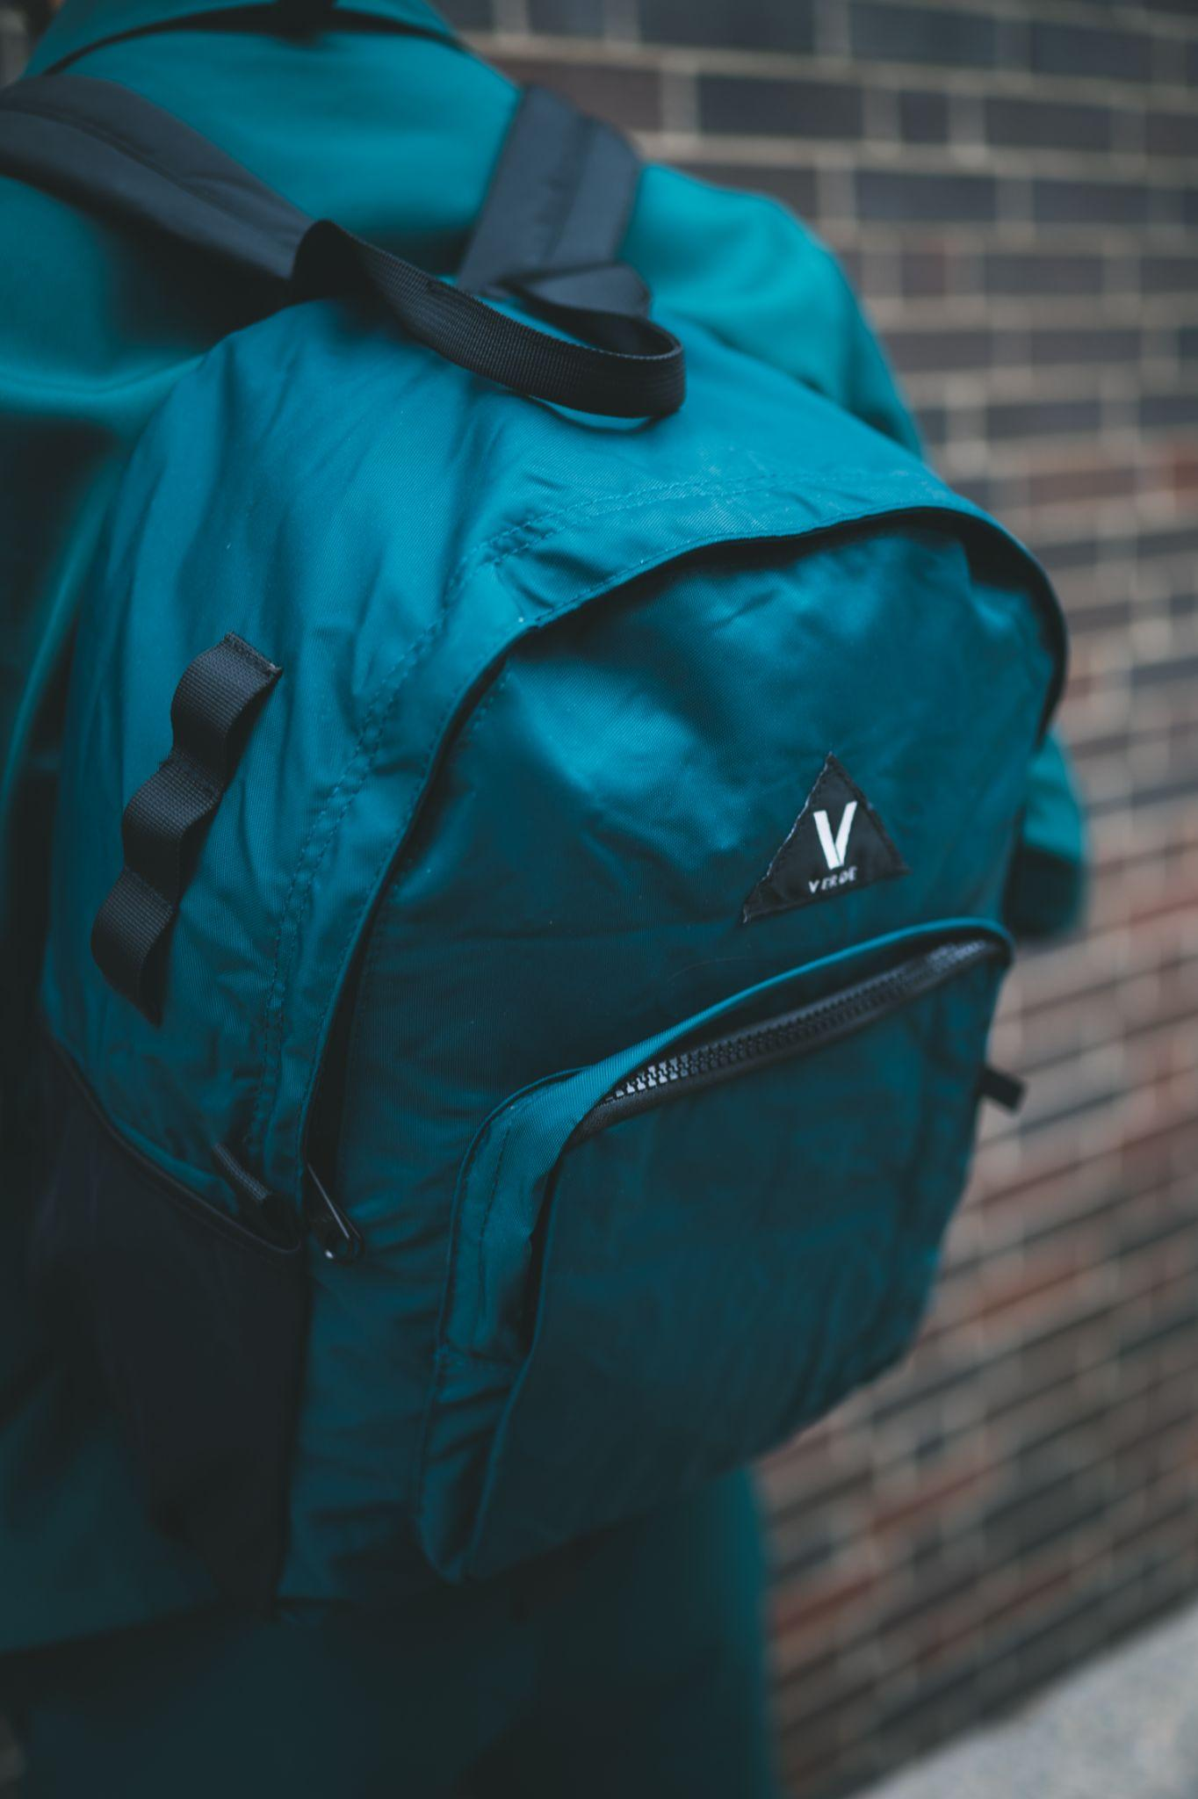
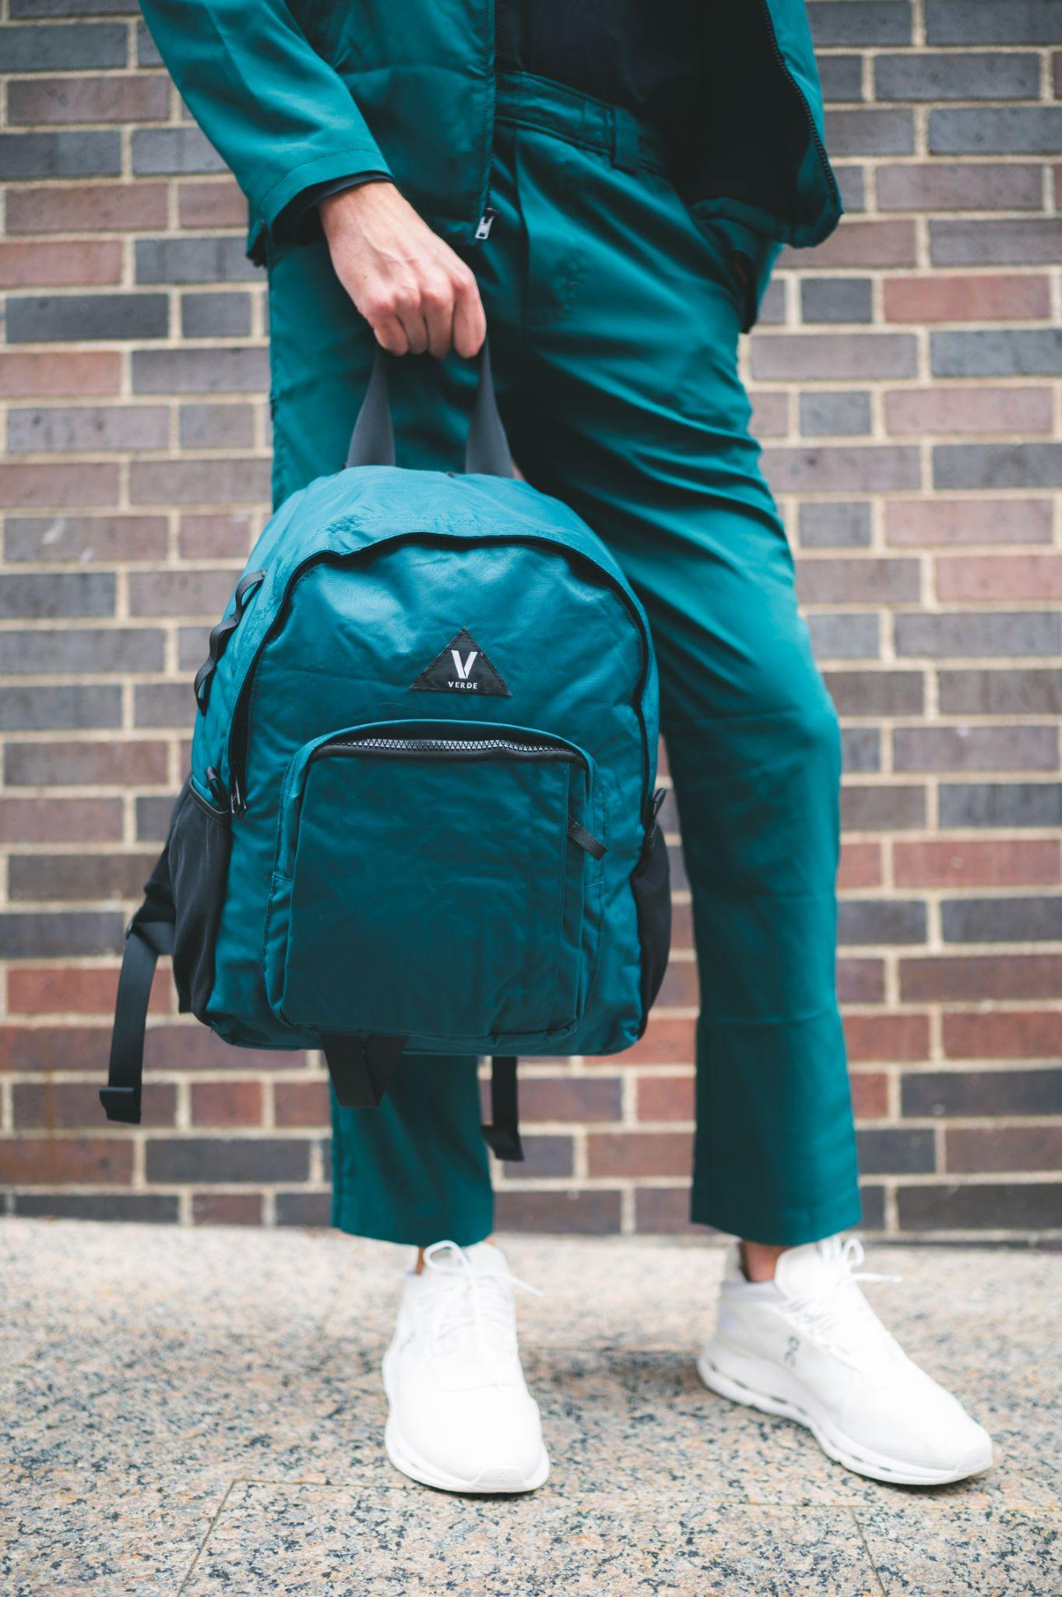
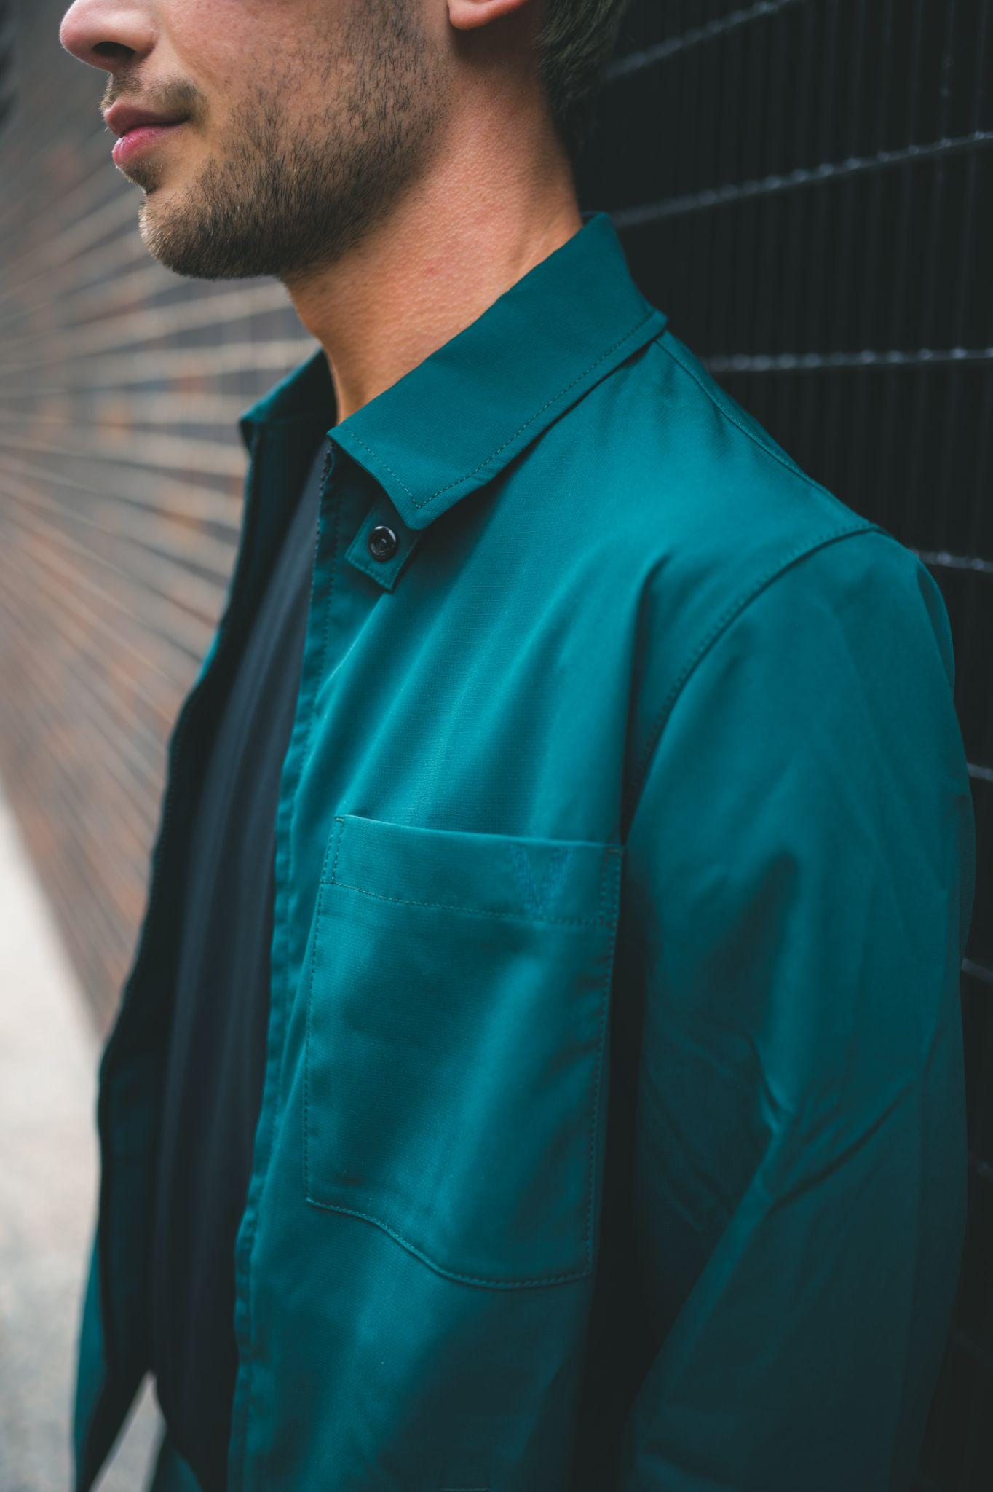
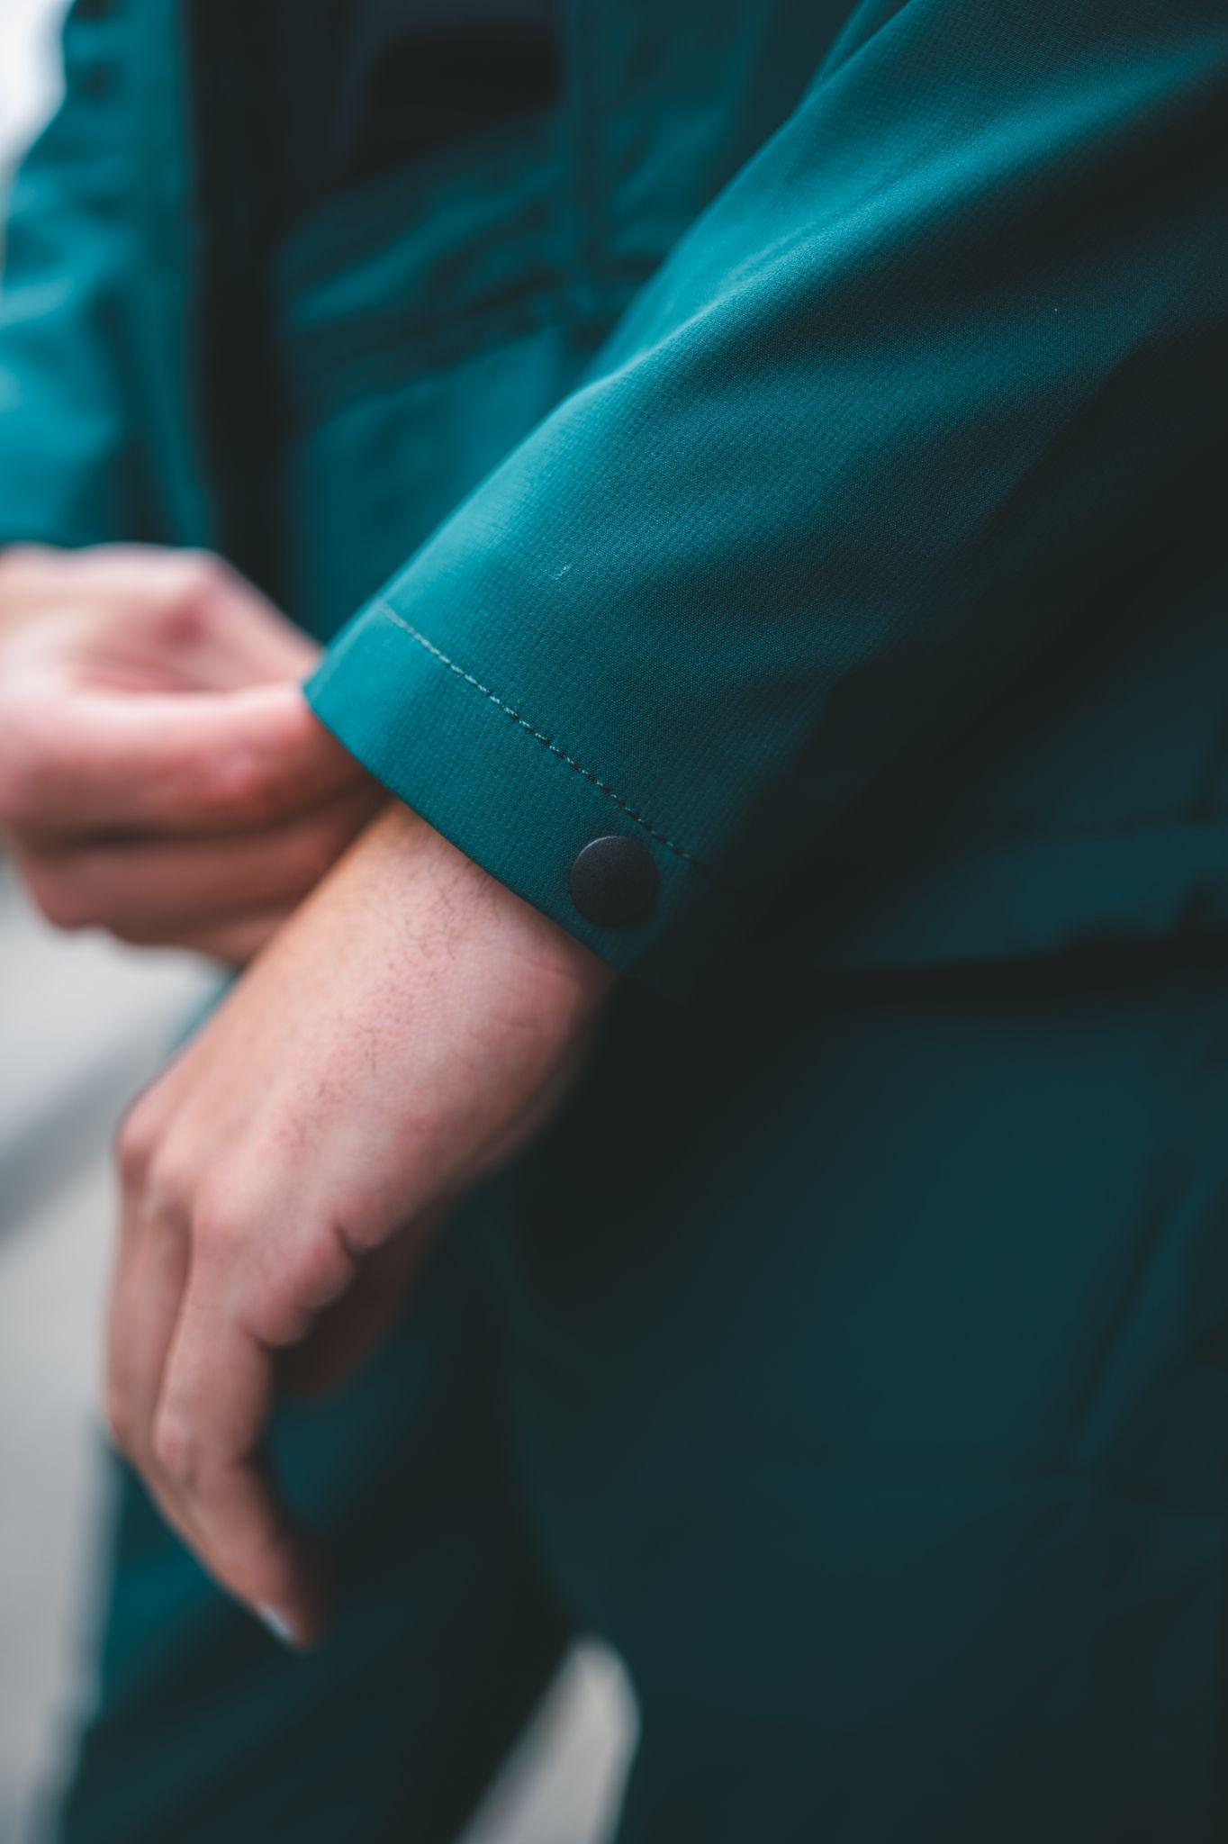
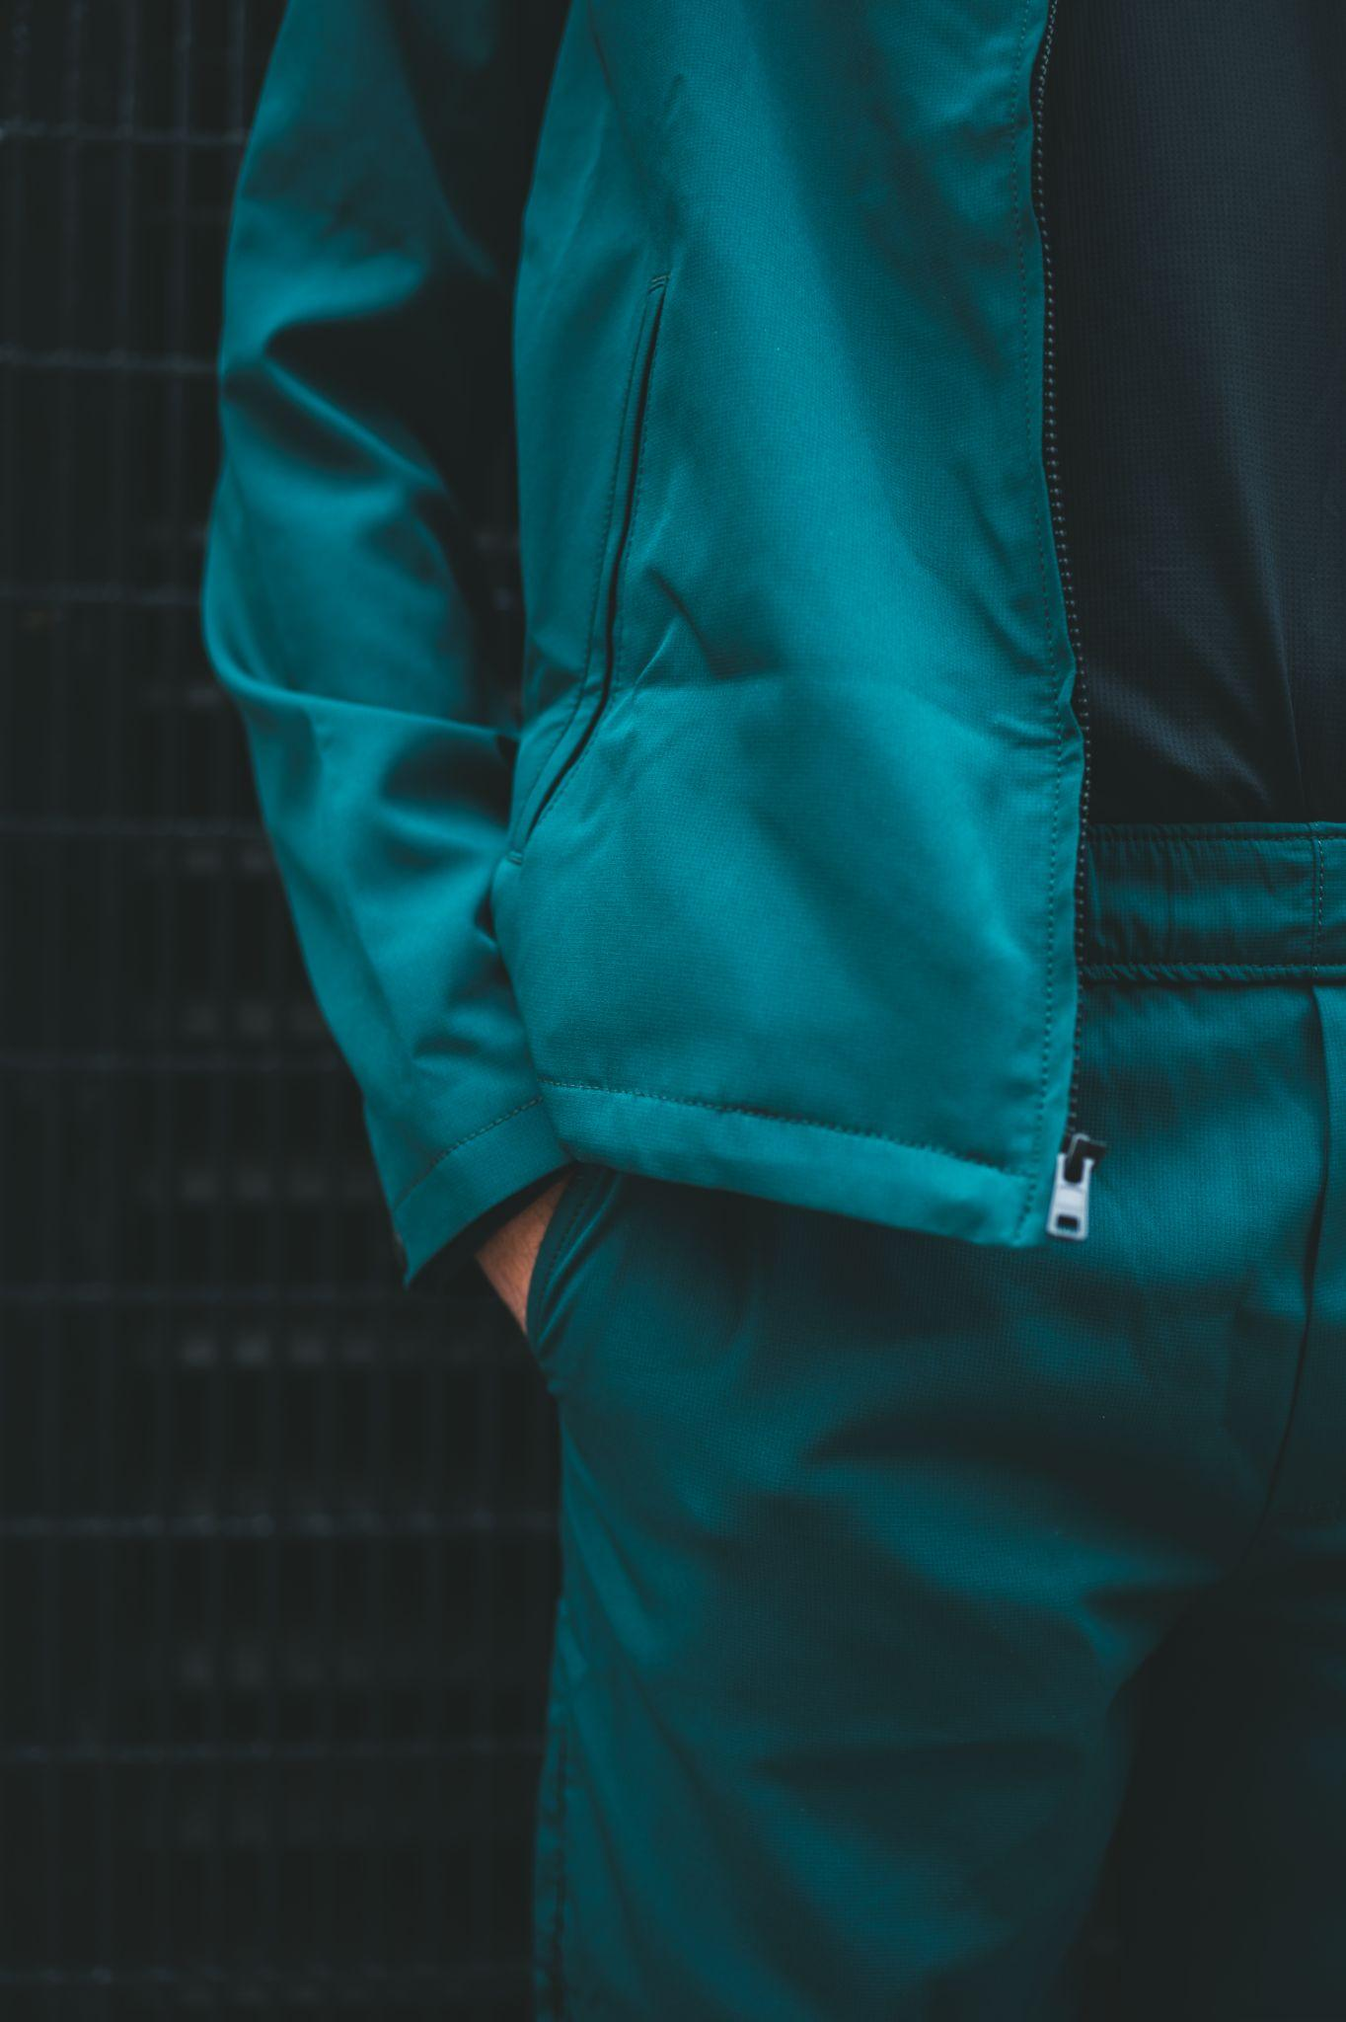
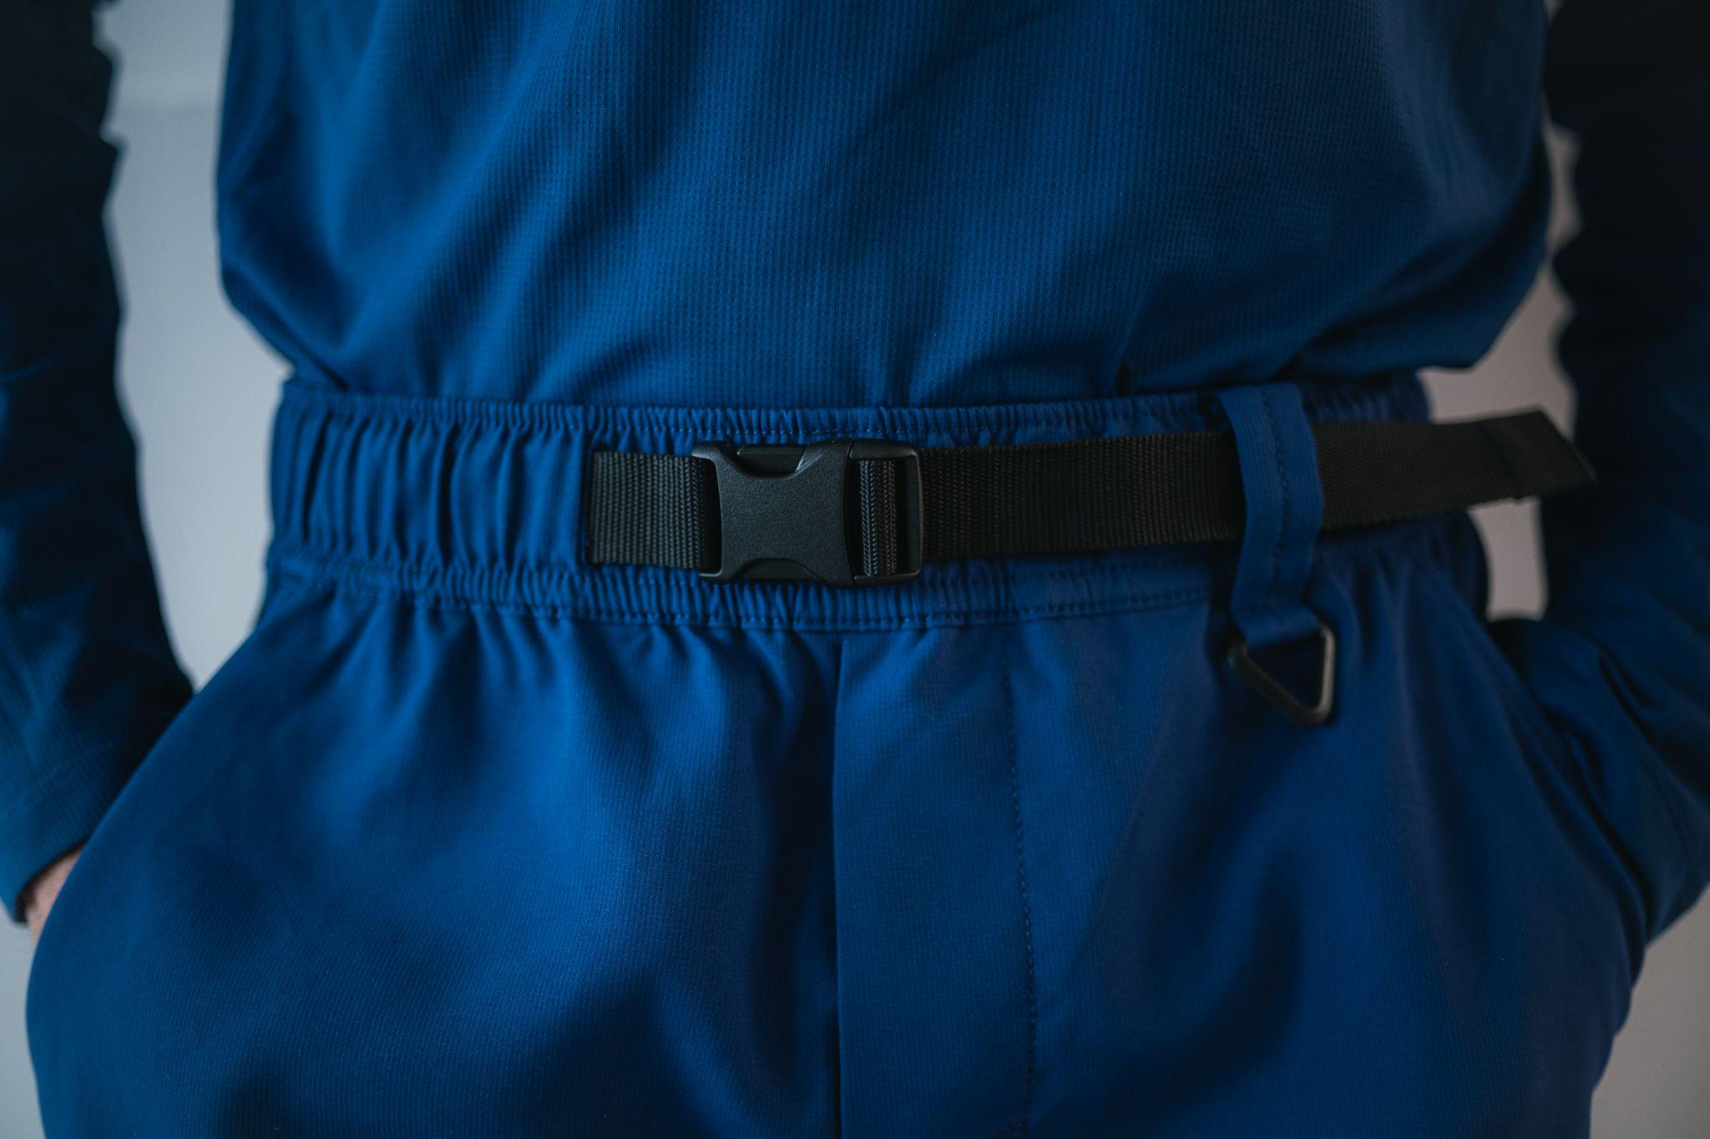
Sample shoot
Notes:
ANGELINA

Slide 13

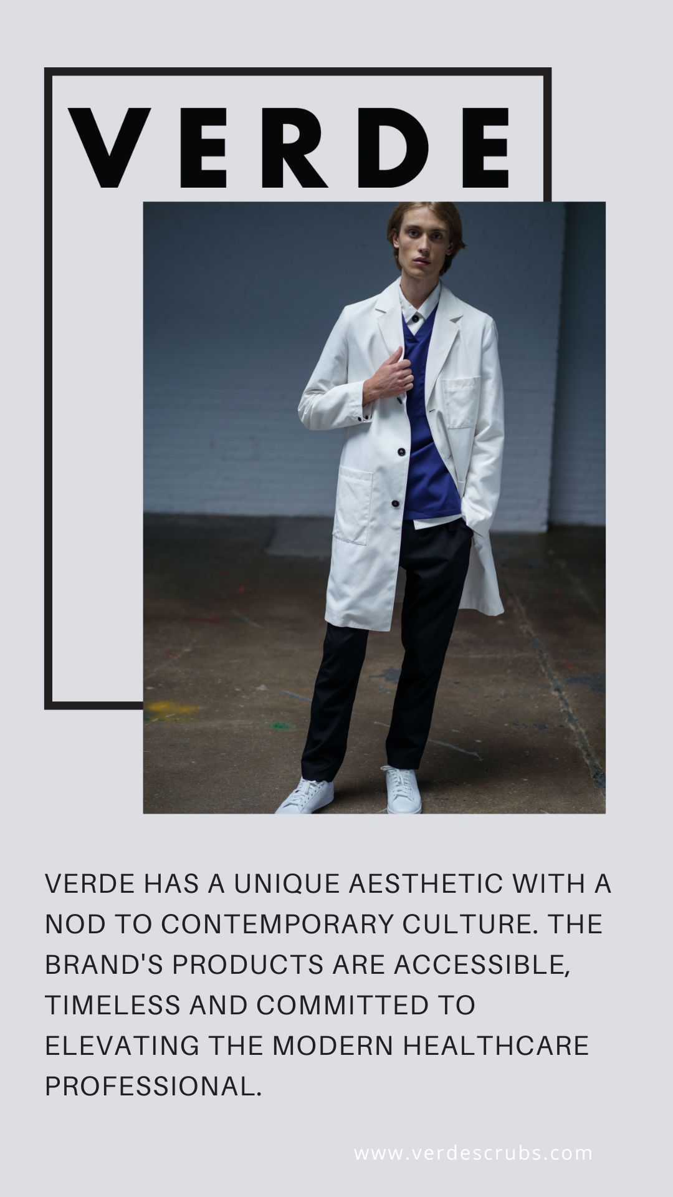
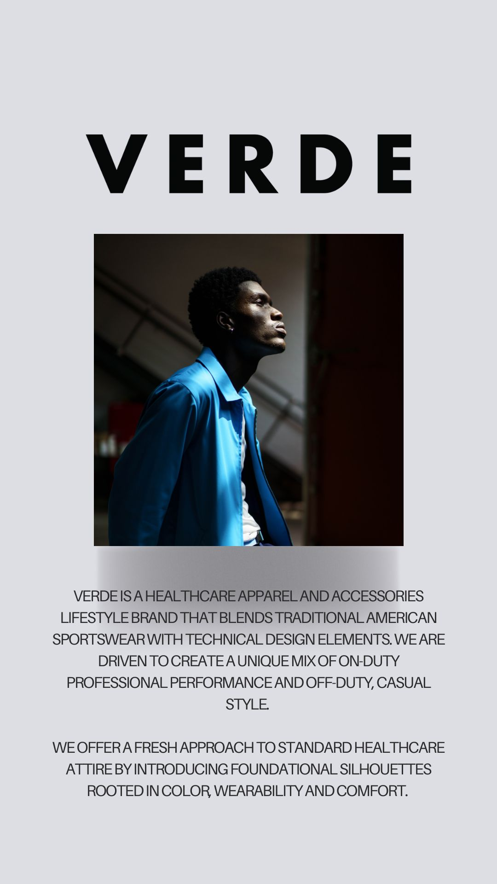
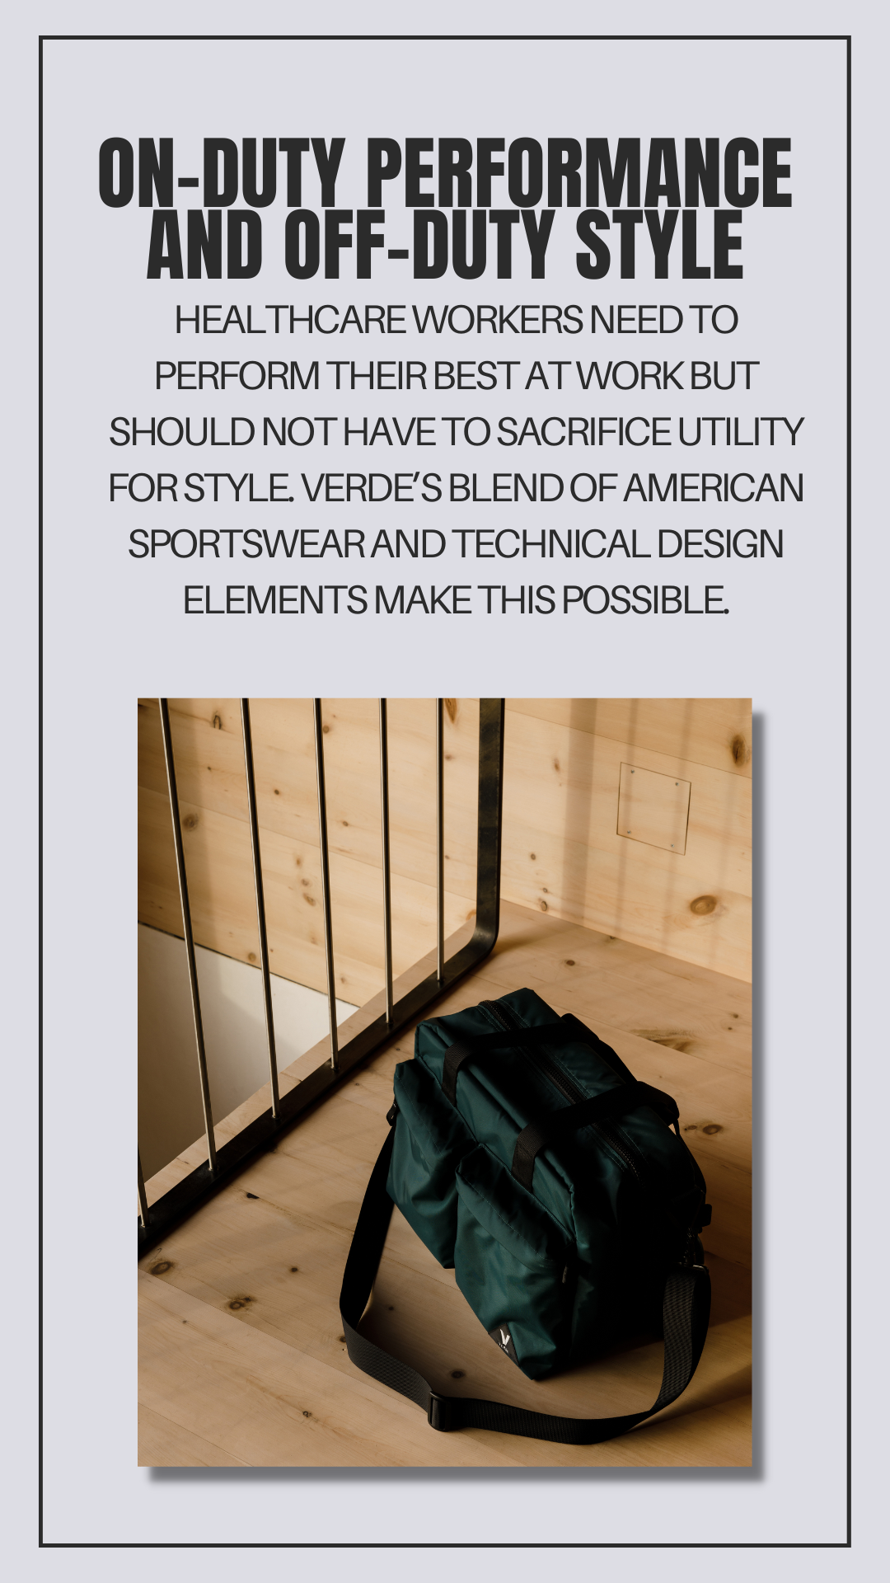
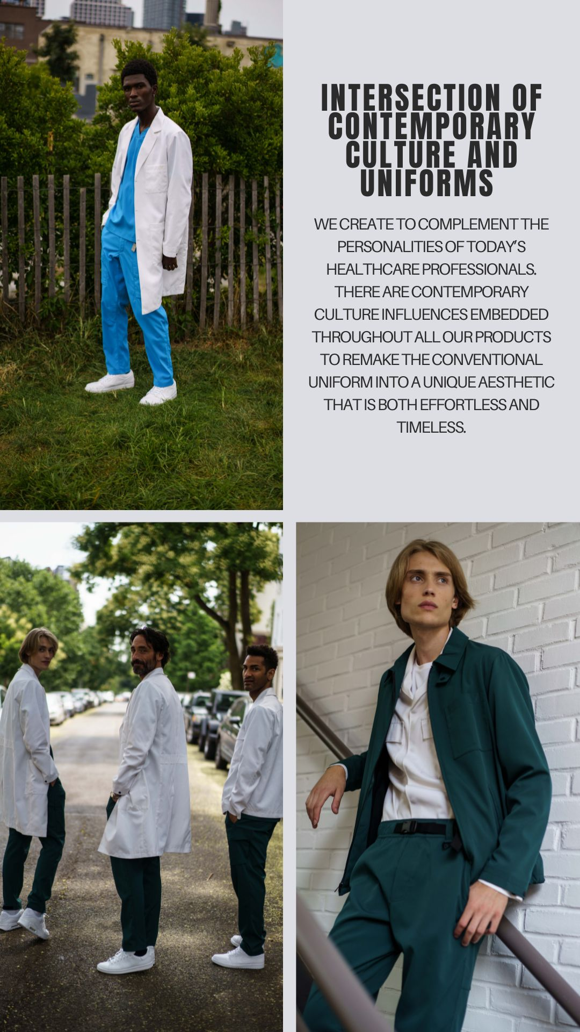
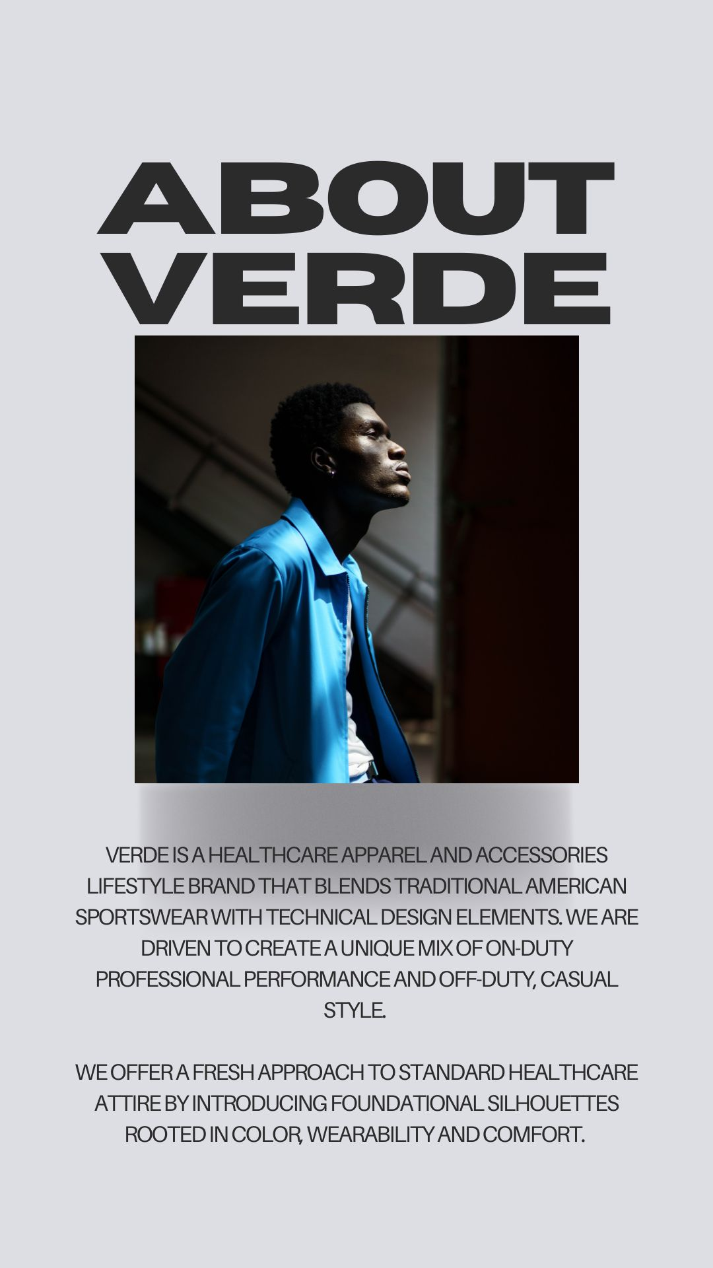
Content creation: IG Highlights
Notes:
LILY

Slide 14
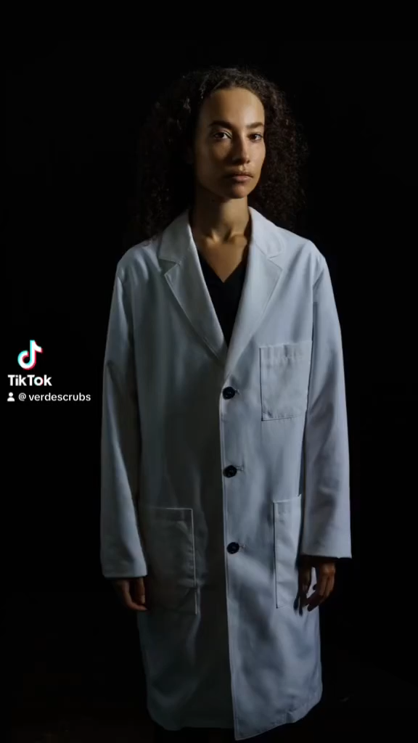
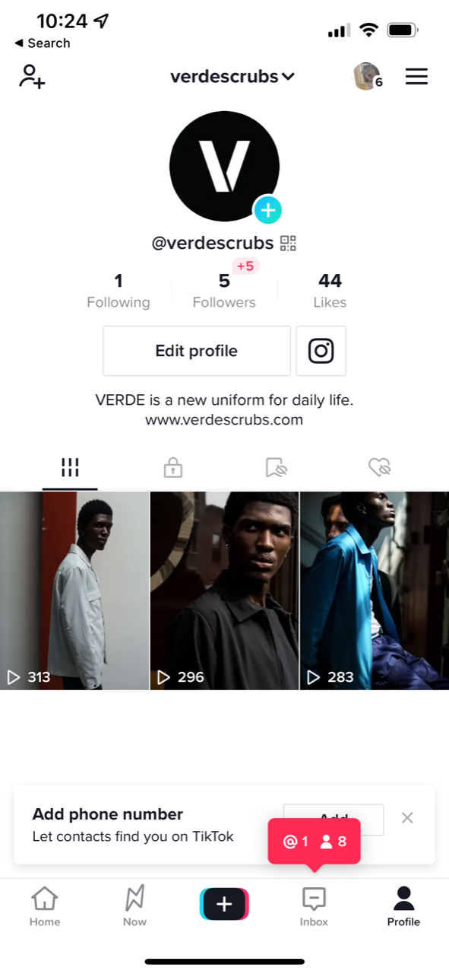
Content Creation: TIkTOK
Notes:
Discuss photographer details, finding shoot locations
ANGELINA

Slide 15
RESULTS
06
Notes:
WENDY

Slide 16
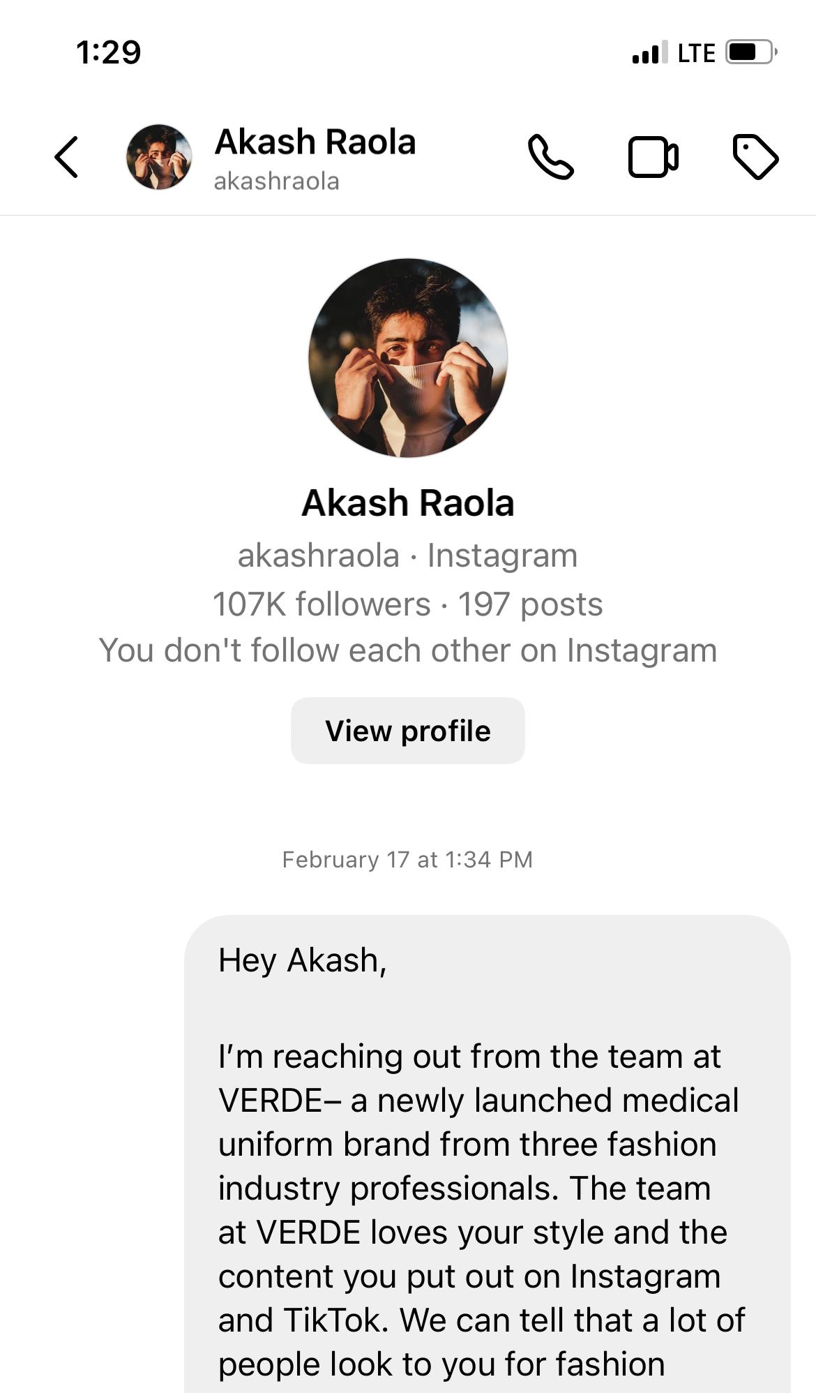
OUTREACH Results
3 Rounds of Influencer outreach
  34 pitches sent; 6 influencers received PRODUCTs
2 rounds of doctor outreach
  13 pitches sent; 3 Doctors Received Products
Notes:
WENDY

Slide 17
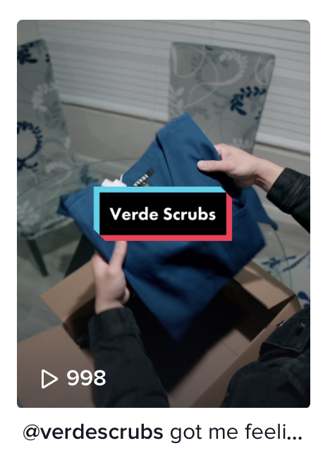
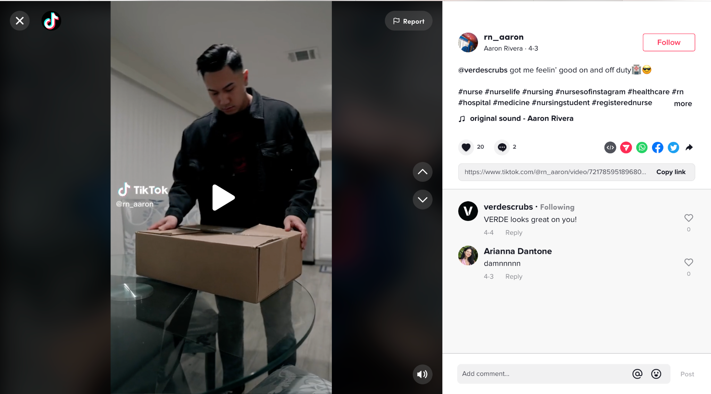
Influencer highlight
Rn_Aaron
  1 discussed paid partnership
  4 Earned media content
  Total views: 36.8k
Notes:
JULES

Slide 18
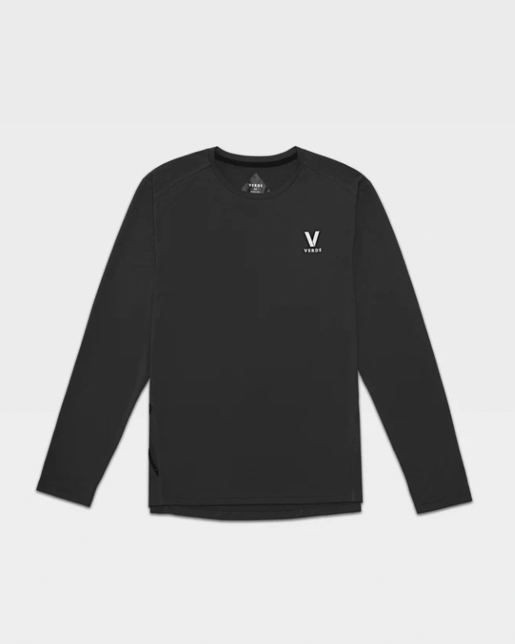
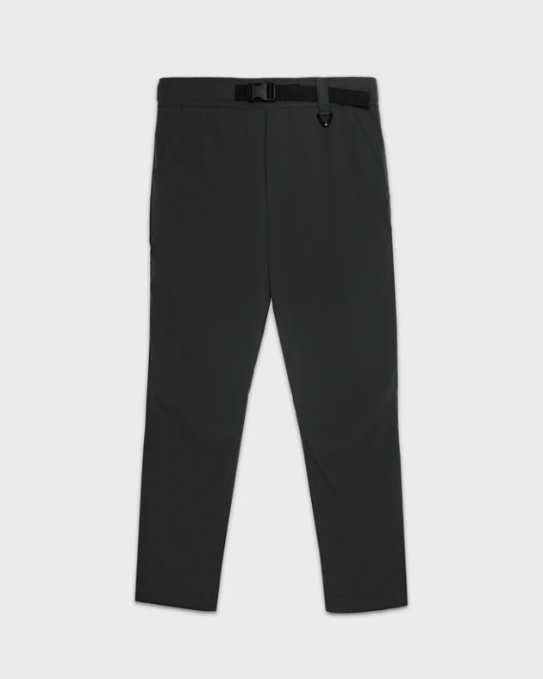
Doctor results
Dr.shahbazian
  Upcoming photo shoot with products
  4 product items sent
Dr. bernier & dr. Altaweel
  reported colleagues asking about VERDE
  7 product items sent
Notes:
WENDY

Slide 19
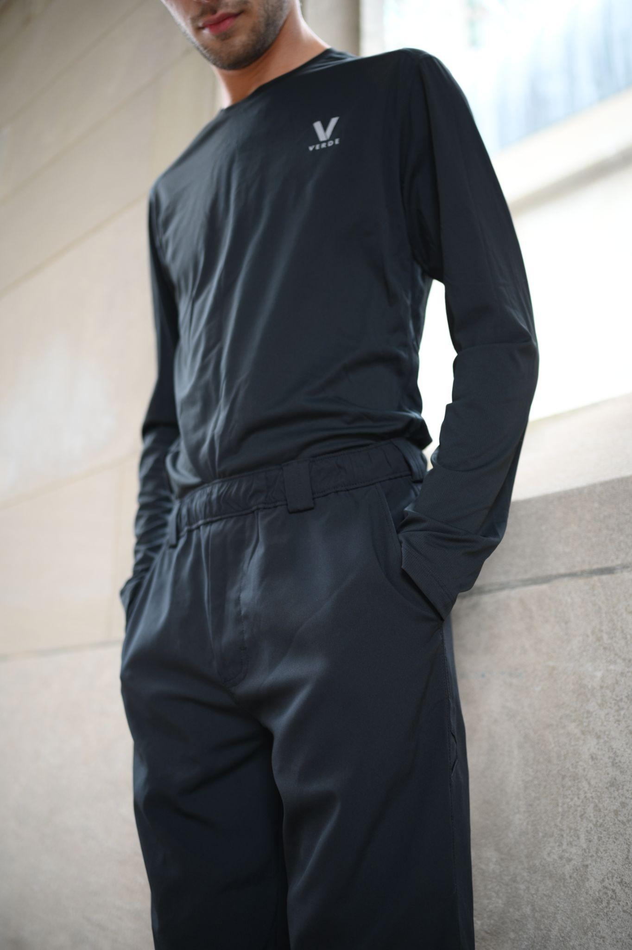
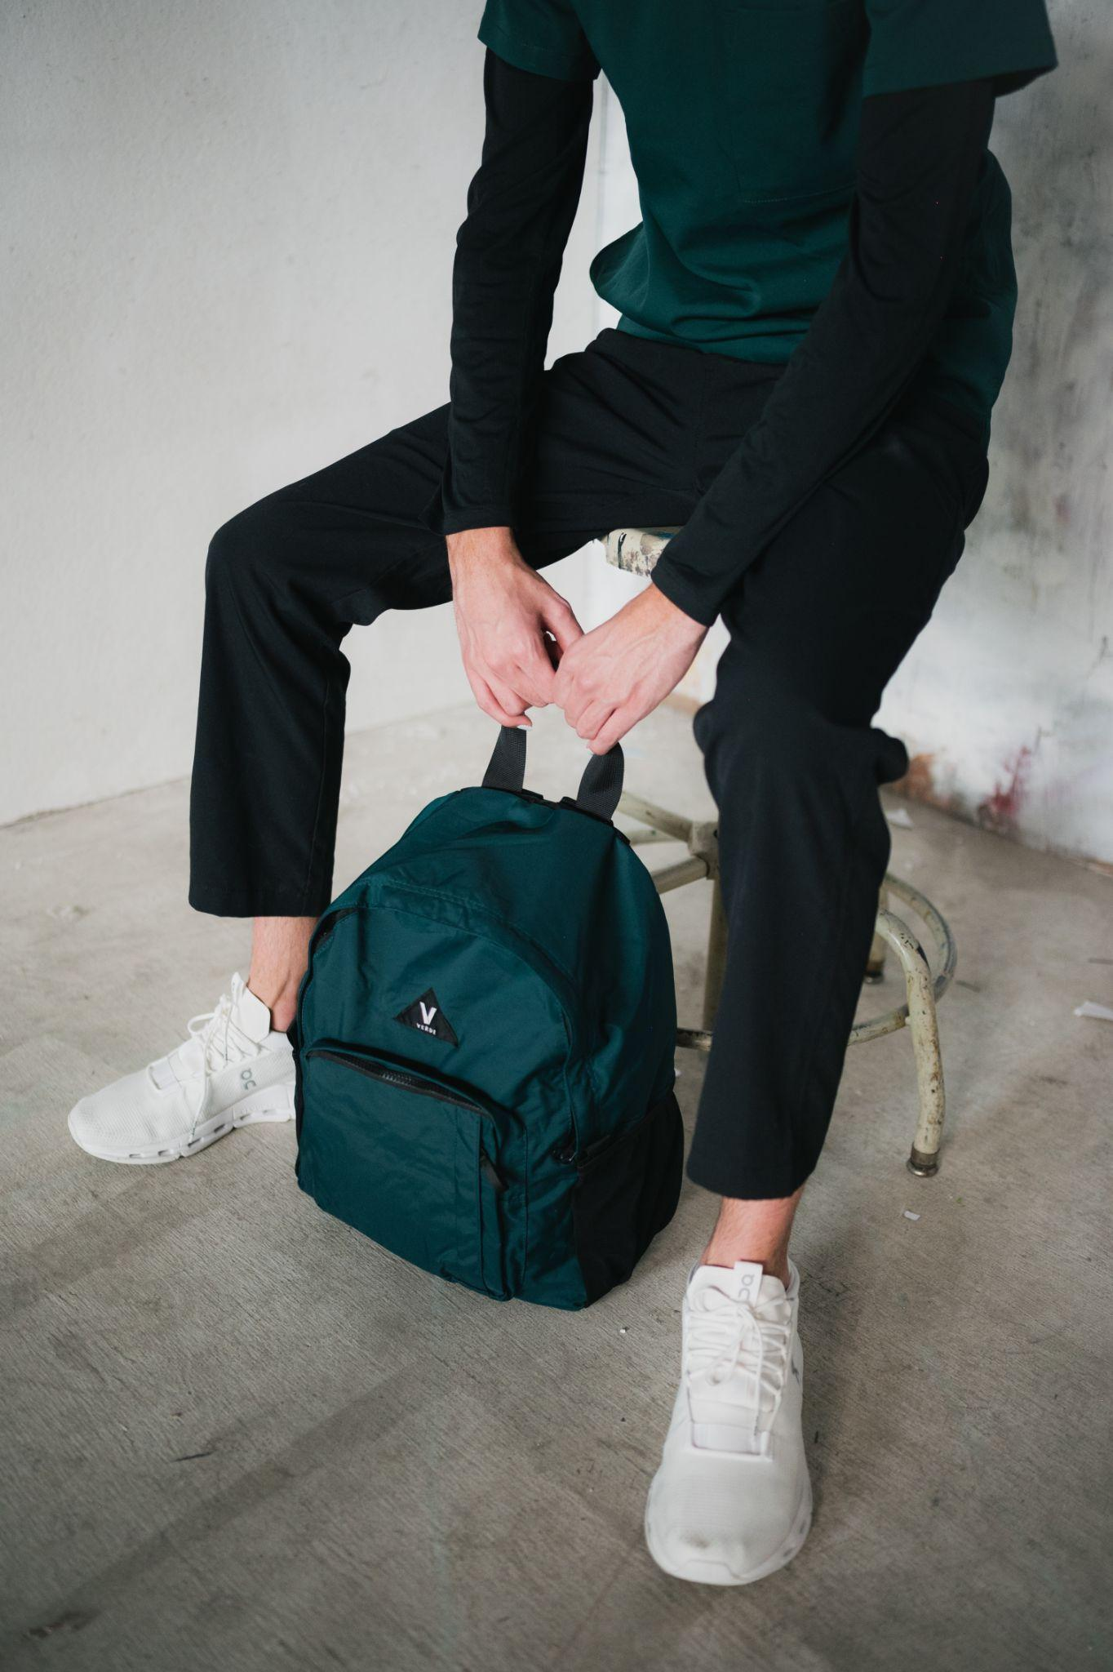
Content Creation Results
195 photos
59 Video Clips
5 drafted sample tiktok POSTS
Notes:
ANGELINA

Slide 20


Social Media Results
Created New Tik ToK account
Posted 3 Videos on Account
Gained 44 likes, 12 followers
~ 300 views per post, 893 TOTAL
National Doctor’s Day Post idea
Created 3 Instagram Story Highlights (+ edit from client)
  137 accounts reached
Notes:
LILY

Slide 21
REflection
07

Slide 22

adaptability
Importance of a follow-up
DEVIL IS IN THE DETAILS
Value of a calendar
Results take time
Can’t force a story
Notes:
JULES

Slide 23
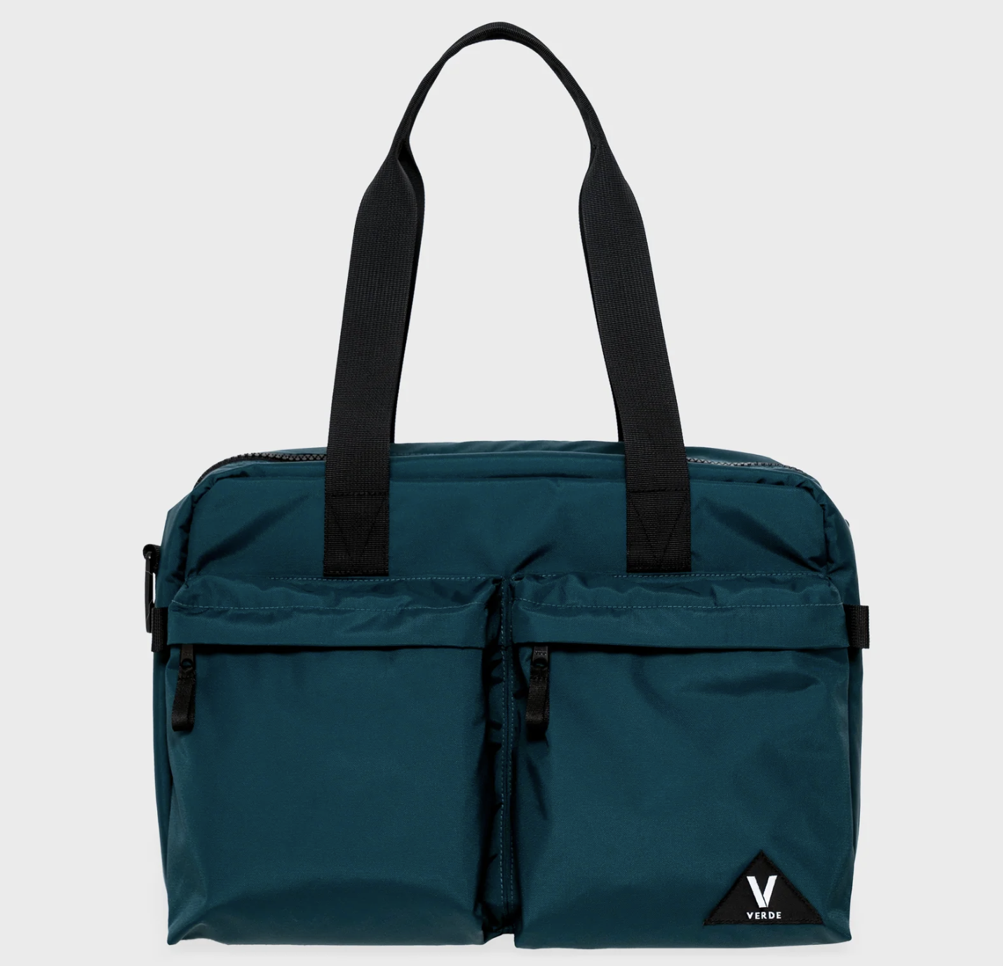

Future opportunities
“WHAT’S IN MY BAG?” VIDEOS
“DOCTORS ON DOCTORS” SERIES
Tiktok product content
Notes:
Discuss photographer details, finding shoot locations

Slide 24
QUESTIONS?
Account Supervisor
Angela Schmidt - (415)-602-4960 - ams16@bu.edu
Account Executives
Juliana Berkowitz - (732)-759-4566 - jmberk@bu.edu
Angelina Engira - (908)-339-7401 - aengira@bu.edu
Jingwen Tan - (617)-943-8568 - jingwent@bu.edu
Lily Yates - (617)-943-7471 - lbyates@bu.edu

